Slide 2
Neoadjuvant Therapy:
Where Are We in 2017
Eric P. Winer, MD
Dana-Farber Cancer Institute
Harvard Medical School
eric_winer@dfci.harvard.edu

Slide 3
When to Administer Preoperative Therapy
For locally advanced and inflammatory cancer where it is standard of care
For operable breast cancer

Slide 4
Focus on Operable Breast Cancer
Local therapy advantages of neoadjuvant approach
  Increase proportion of patients eligible for conservative surgery
  Avoid, in some cases, need for reconstruction and radiation
  Decrease need for full node dissection
Additional advantages
  Predict results of adjuvant trials or change adjuvant standards ???????
  Determine sensitivity to treatment and adjust post-surgery treatment
Of course, neoadjuvant therapy can only be given if you are certain that the treatment is needed (e.g. if you are not certain that a patient would receive chemotherapy in adjuvant setting, you cannot give neoadjvuant chemotherapy

Slide 5
Surgical Advantages of
Neoadjuvant Therapy
Increase breast conservation
  In spite of high clinical response rate and moderate pathologic complete response rate, increase in conservation is modest
    -- patient preference
    -- physician assessment of operability (lumpectomy)
    -- “the diffuse calcification challenge”
Decrease need for axillary dissection

Slide 6
Breast Surgery by pCR in the Breast in Z1071
N=694
Boughey et al, Ann Surg. 2014 Oct;260(4):608-16

Slide 7
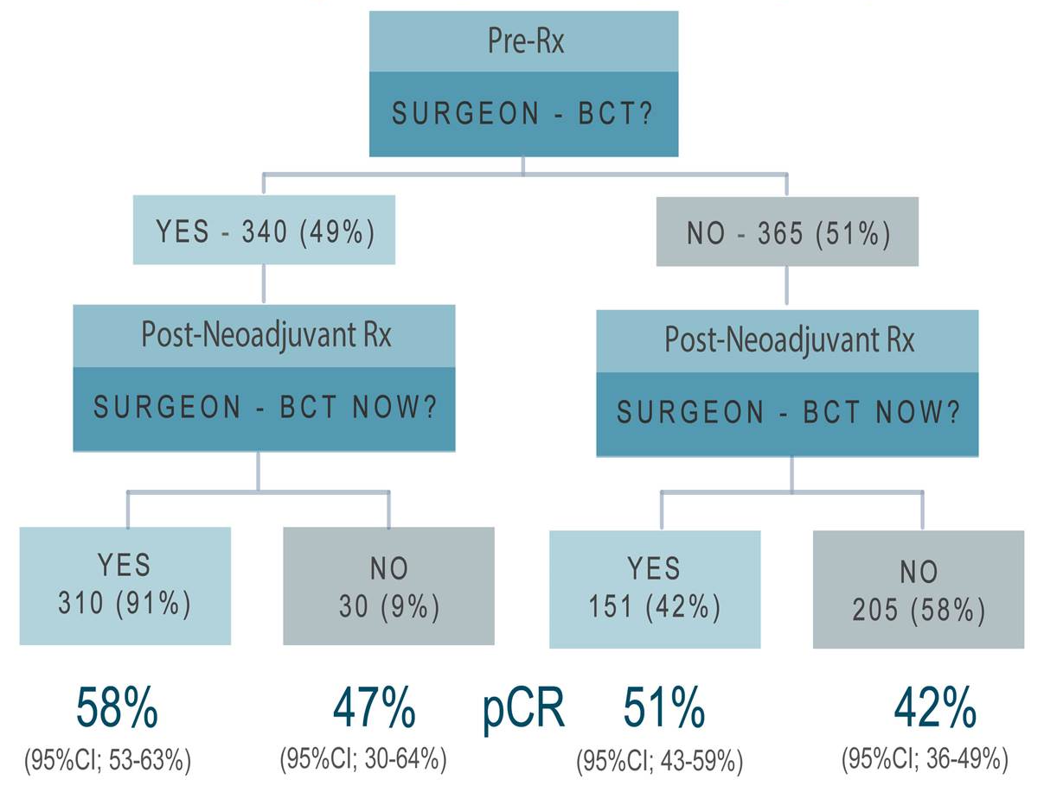
BCS Rate Could Be Higher
Analysis from CALGB HER2+ and TN Preop Trials
N=710
Golshan M et al, ASCO 2015

Slide 8
Axillary management after NAC:
Positive Nodes at Presentation
Is SLNB an option if nodes respond?
  Z1071
  SENTINA
  SN FNAC

Slide 9
Z1071 Schema
T0-4, N1-2, M0 invasive breast cancer
(pretreatment axillary ultrasound with FNA or core biopsy
documenting axillary metastases)
↓
REGISTER*
↓
Neoadjuvant chemotherapy
↓
REGISTER*
↓
SLN and ALND

Slide 10
False Negative Rate in cN1 patients with 2 or More SLNs examined
310 patients
p Value
Mapping Agent
Blue dye only
2/9 (22.2%)
10/50 (20.0%)
27/251 (10.8%)
Radiolabeled colloid only
Both blue dye and
p = 0.046
radiolabeled colloid
Number of SLN Examined
2
19/90 (21.1%)
3
7/78 (9.0%)
p = 0.004
4
4/60 (6.7%)
5+
9/82 (11.0%)

Slide 11
Pathological Complete Response Rates in the Axilla
HR Positive,
Triple Negative HER2 Positive HER2 Negative
21.1%
49.4%
64.7%
p<0.0001
Boughey et al. Ann Surg Oct 2014; 260 (4); 608

Slide 12
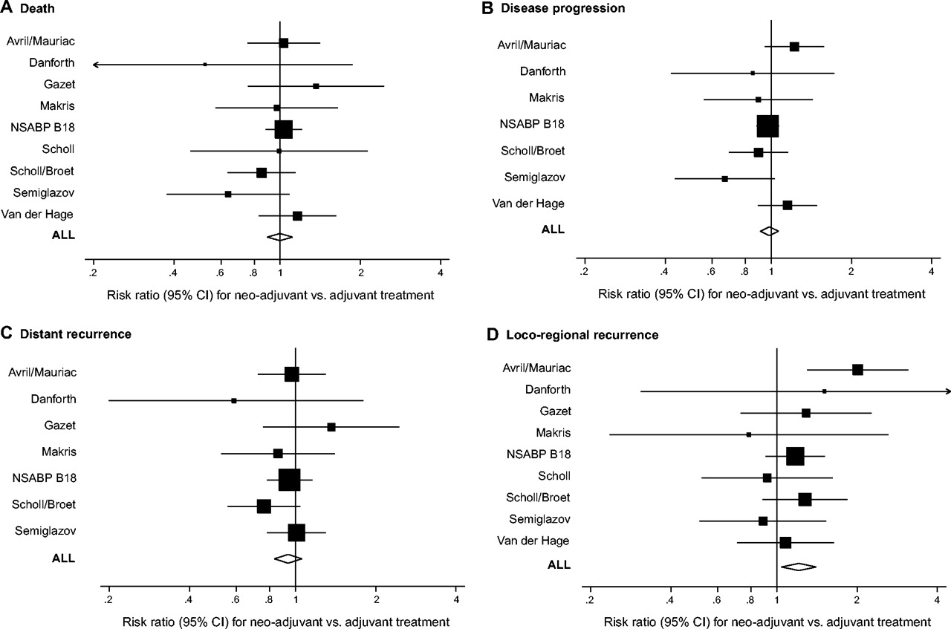
Meta-Analysis of Preoperative vs Postoperative Chemotherapy
Death
Disease Progression
Distant Recurrence
analysis for primary outcomes with adjuvant therapy for breast cancer.
But most studies of modest size and
entire cohort only included
3946 patients
Ability to look for differences in
subtypes limited
Mauri D et al. JNCI J Natl Cancer Inst 2005;97:188-194
Journal of the National Cancer Institute, Vol. 97, No. 3, © Oxford University Press 2005, all rights reserved.
Notes:
Meta-analysis for primary outcomes with neoadjuvant therapy compared with adjuvant therapy for breast cancer. In each panel, each study [Van der Hage et al. (8), Avril et al./Mauriac et al. (9,10), Semiglazov et al. (11), Scholl et al. (12), Scholl et al. (13), Broet et al. (14), Makris et al. (15), NSABP B-18 (16,17), Gazet et al. (18), Danforth et al. (19)] is shown by the point estimate of the risk ratio (square proportional to the weight of each study) and 95% confidence interval (CI) for the risk ratio (extending lines); the summary risk ratio (ALL) and 95% confidence intervals by fixed effects calculations are also shown by diamonds. For all panels, values greater than 1 indicate that neoadjuvant treatment has a worse outcome compared with adjuvant treatment. (A) Death. (B) Disease progression. (C) Distant disease recurrence. (D) Loco-regional disease recurrence. Arrow = 95% confidence interval extends beyond the depicted range.

Slide 13
Disease-Free and Overall Survival
According to Response
80%
100%
pCR
pCR
60%
pINV
P=0.00005
pINV
P=0.0008
40%
cPR
cPR
20%
cNR
cNR
HR for DFS HRS for OS
< pCR 1 1
pCR (13% of pts) 0.47 (p <0.0001) 0.32 (p <0.0001)
0
16 Year F/U
Year
2
4
6
8
2
4
6
8
Wolmark, et al. J Natl Cancer Inst Monogr 2001, Rastogi et al. J Clin Oncol 2:778-785, 2008.

Slide 14
The Addition of Docetaxel to AC:
NSABP B-27
AC x 4
SURGERY
Operable
Breast Cancer
AC x 4
DOC x 4
SURGERY
AC x 4
SURGERY
DOC x 4
N = 2411
Accrual 12/95-12/00
Concurrent tamoxifen for all
Bear et al., J Clin Oncol 24:2019-2027

Slide 15
NSABP B-27: Pathologic Complete Responses in the Breast
26.1%*
TREATMENT ARM pCR Rate
AC – Surg* 12.8%
AC – Doc – Surg* 26.1%
AC – Surg – Doc* 14.3%
14.3%*
12.8%*
*p<0.001 for test of heterogeneity across groups
It was widely assumed that this improvement in pCR would
lead to a clinical and statistically significant benefit in DFS/OS
Bear et al., J Clin Oncol 24:2019-2027

Slide 16
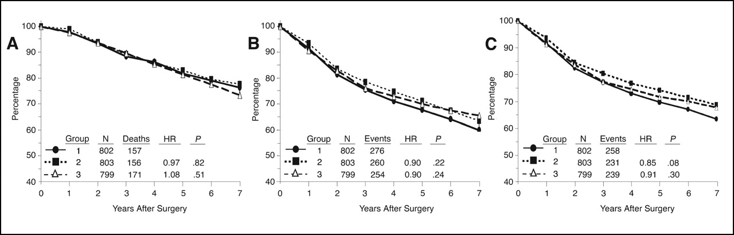
Overall, Disease-Free, and Relapse-Free Survival For Addition of Docetaxel to AC
NO SIGNIFICANT DIFFERENCE
Many have argued that the failure to see a survival difference was because the patient population was mixed and a high proportion had ER+ disease
Bear, H. D. et al. J Clin Oncol; 24:2019-2027 2006
Notes:
16

Slide 17
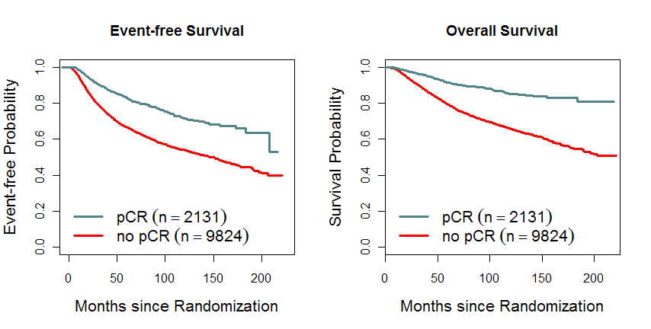
Association of pCR on EFS and OS
HR=0.48, P* < 0.001
HR=0.36, P* < 0.001
pCR=ypT0/is ypN0
* Nominal p-value
Cotezar et al, AACR 2013, Lancet 2014

Slide 18
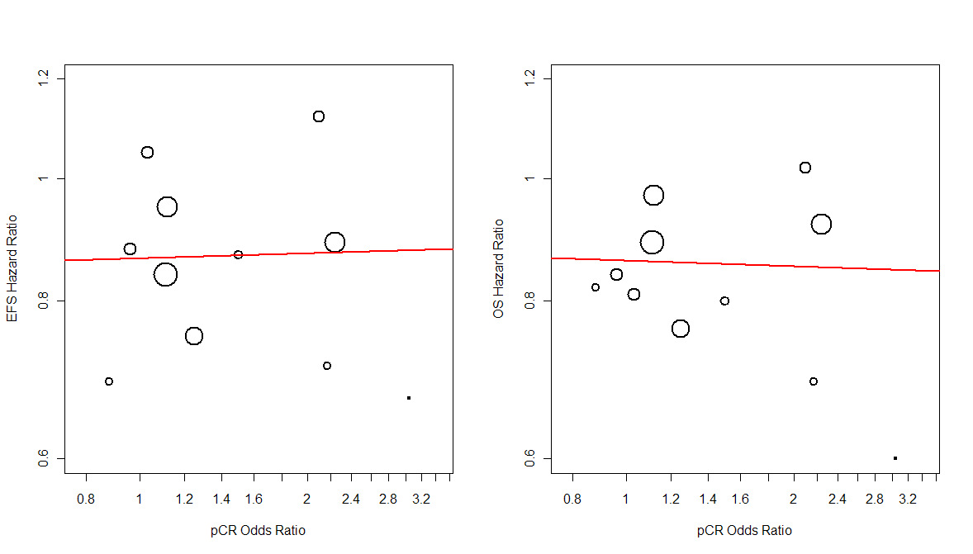
The Magnitude of Improvement in
pCR Rate Did Not Predict EFS and OS Effect
R²=0.01
R²=0.18

Slide 19
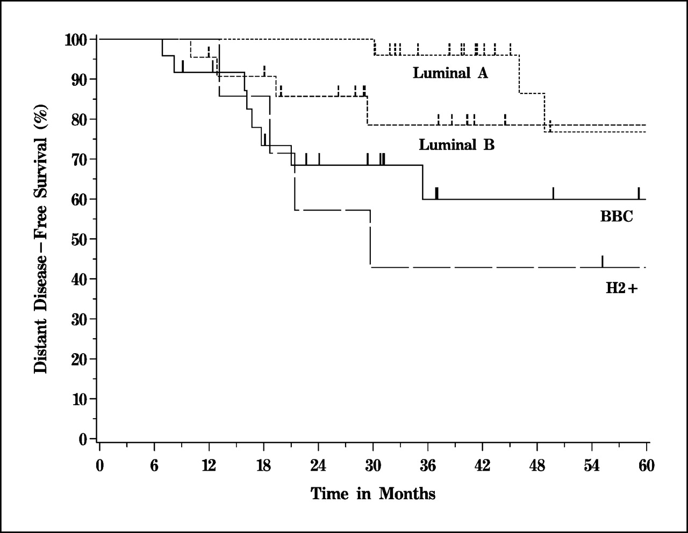
Failure to Achieve pCR is Still Associated With Good Outcome in ER+ Cancers, Particularly Luminal A
Carey et al, Clin Cancer Res 2007;13:2331

Slide 20
Pathologic CR Rates By Tumor Subtype
34
Grade 1-2 Grade 3
No Tras Yes Tras
HER2+ HR+
No Tras Yes Tras
HER2+ HR-
TRIPLE NEG
HR+
Cotezar et al, AACR 2013, Lancet 2014

Slide 21
pCR Rates With Neoadjuvant Lapatinib Containing Regimens
Pac Pac→FEC FEC → Pac EC → Doc
Courtesy of HJ Burstein

Slide 22
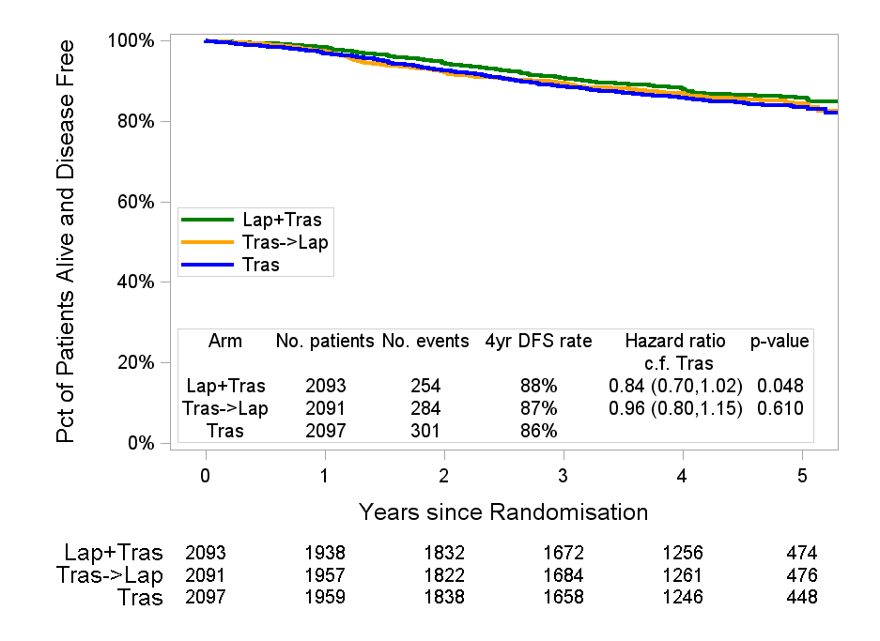
ALTTO: Disease Free Survival (DFS) Analysis
HR=0.84 for T/L vs T
MFU = 4.5 yrs
*
**
* 97.5% CI
**p-value ≤ 0.025 required for statistical significance
Picart et al, ASCO 2014

Slide 23
Why Does The Difference in Pathologic Response Rates in Randomized Preoperative Trials NOT Predict Long Term Outcome?
NO
CR
NO
CR
70% cured
30% relapse
Improvement
will only lead
to better DFS
if these are
patients who
would have
previously
relapsed
CR
20%
90% cured
10% relapse
CR
Patients With
CR As A
Result of
New Regimen
Standard Rx
CR=30%
New Rx
CR=50%

Slide 24
Time for a New Approach When it Comes to
Systemic Therapy Questions?
Maybe we should give up looking for “better” regimens that can be used in the adjuvant setting
Instead, we can:
  Maximize the biologic insights we obtain from neoadjuvant trials
  Explore ways in which we can de-escalate therapy by considering the importance of pathologic CR as a powerful biomarker for the individual patients

Slide 25
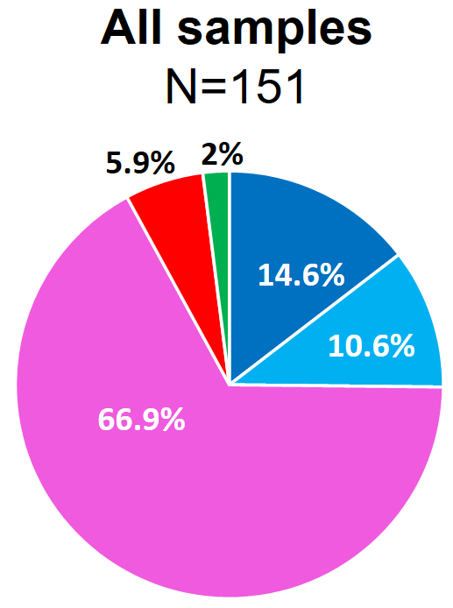

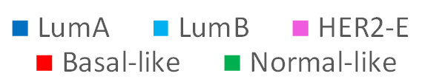
Intrinsic Subtype at Baseline vs. pCR in the Breast
Baseline samples (N=151)
pCR
∆=30.6%
∆=24.7%
40.6%
34.7%
pCR rate
10.0%
10.0%
Prat et al. SABCS 2016; Lancet Oncol 2017

Slide 26
pCR Associated with Immune Cell Signatures in CALGB 40601
Activity of 5 immune signatures tested:
B-cell
T-cell
CD8 T-cell
IgG
“HER2+ immune cell”
All significantly associated with ⬆ pCR
P<0.001
Carey et al, ASCO 2014
Iglesia et al, CCR in press; Fan et al, BMC Med Genomics 2011
Notes:
NEED CITATIONS FOR EACH OF THESE SIGNATURES. SHOULD WE DO TIL ANALYSIS IN THESE TISSUES?
Talk with Luca about these data
Points to make: In NeoSphere, PDL1 and CTLA4 were associated with pCR. Similarly we found that a variety of immune signatures were associated with pCR. Investigators from BIG have found that benefit of trastuzumab appears heavily influenced by the presence of substantial tumor-infiltrating lymphocytes. We examined a variety of signatures. In all cases, an activated signature was associated with higher pCR rates regardless of dual or single HER2 therapy.

Slide 27
De-escalating Therapy in HER2+ Stage II/III Disease
Paclitaxel, Trastuzuamb, Pertuzumab
pCR
Limited therapy
and follow
HER2+
Stage II/III
No pCR
Sample size will depend on confidence
intervals for phase II study of CR patients
and phase III of high risk patients
Comprehensive Tissue/Blood
Collection and Analysis
AC
AC
Plus Investigational
Agent

Slide 28
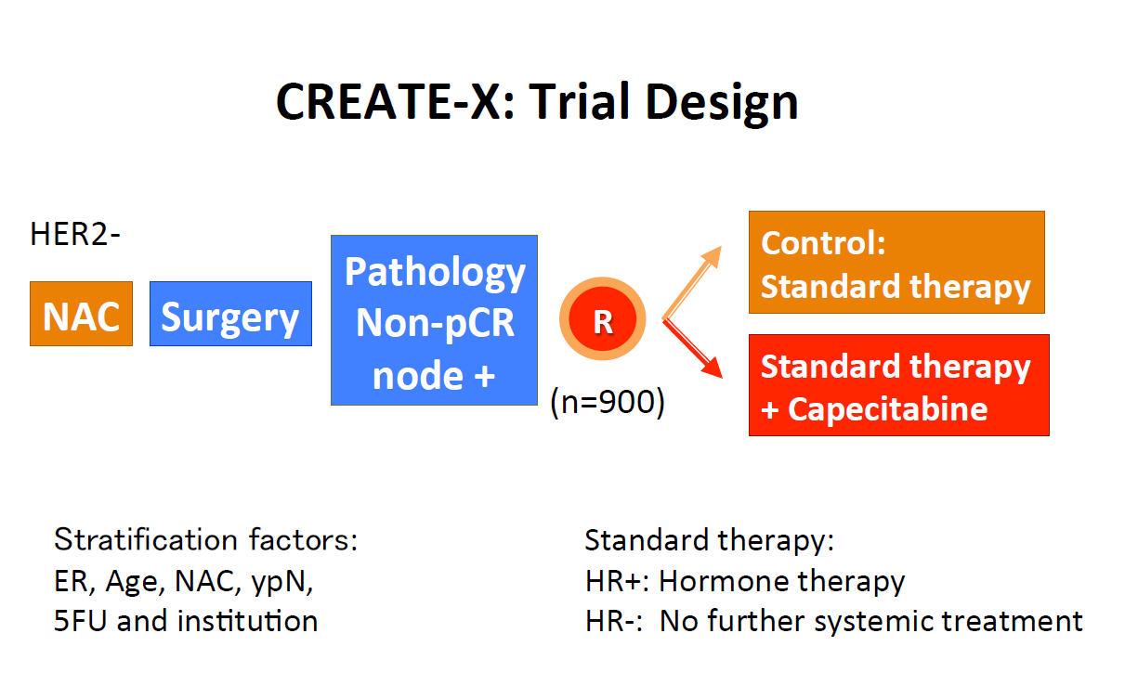
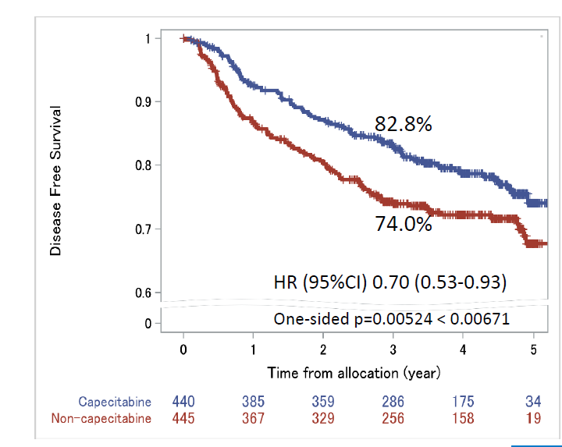
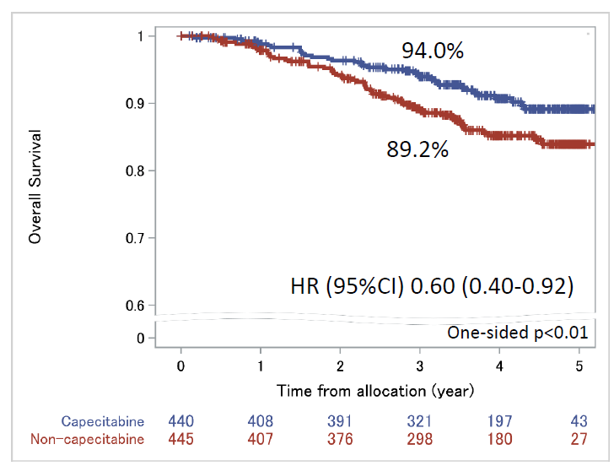
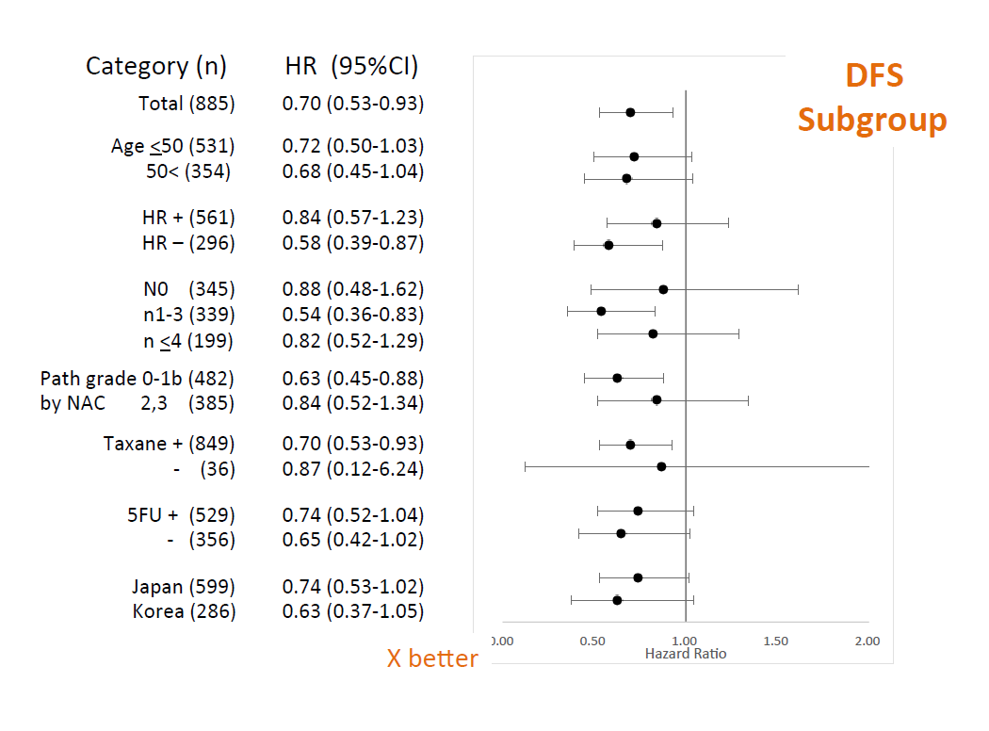
CREATE-X Trial Design
Eligibility: HER2- with residual disease after A- and T-containing NAC
Dose: 2,500 mg/m2/day, D1-14, x 8 cycles (24 wks)
DFS OS
Toi et al; NEJM 2016
Notes:
Capecitabine as a single agent has not been that impressive in earlier studies, and prior studies in the adjuvant setting have not been positive. That’s what’s odd about this, and also that a fairly large proportion of patients had received 5-FU before they got capecitabine

Slide 29
Neoadjuvant Setting is Here to Stay
Decreases extent of surgery
Allows for biologically oriented trials
Provides meaningful prognostic implications
May allow for additional treatment (e.g. capecitabine) in those with residual disease
May provide an opportunity to de-escalate and escalate therapy in a thoughtful manner

