Slide 2
Breast Cancer and Fertility Preservation
Ann H. Partridge, MD, MPH
Dana-Farber Cancer Institute
November 18, 2017
Notes:
25min

Slide 3
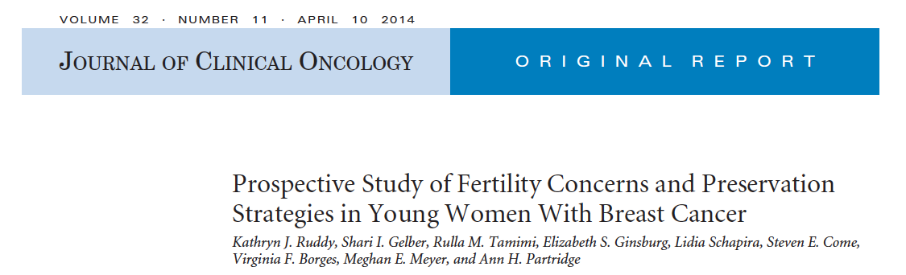
Around 40-50% of young women are concerned about
future fertility at BC diagnosis
Ruddy KJ et al; J Clin Oncol 2014

Slide 4
Rising Trend of Delaying Childbearing
Mathews T & Hamilton B; NCHC 2009

Slide 5
ASCO Recommendations for
Fertility Preservation
•
•
Assessment of risk for infertility
Assessment of risk for infertility
•
•
Communication with patient
Communication with patient
•
•
-
Patient at risk for treatment induced infertility
•
•
Patient interested in fertility preservation options
Patient interested in fertility preservation options
Refer to specialist with expertise in fertility preservation
Refer to specialist with expertise in fertility preservati
Eligible for proven fertility preservation method
Eligible for proven fertility preservation method
Investigational fertility
Investigational fertility
preservation technique*
preservation technique*
Male:
Male:
Female:
Female:
sperm
Embryo
cryopreservation
sperm
cryopreservation
cryopreservation
cryopreservation
•
Cryopreservation
of
Oocyte cryopreservation
testicular or ovarian tissue
oophoropexy
oophoropexy
conservative gynecologic surgery
*Clinical trial participation
Ovarian suppression
encouraged
www.asco.org (Modified from Lee et al., J Clin Onc; 2006)

Slide 6
Options for Fertility Preservation in Breast Cancer
Oocyte/embryo cryopreservation
Cryopreservation of ovarian tissue
Ovarian suppression with LhRH through treatment
Oocyte donation/ gestational surrogacy
Notes:
6

Slide 7


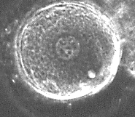
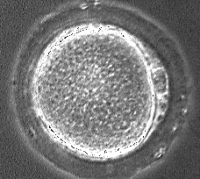
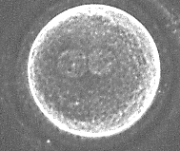
IVF Fertility Preservation Techniques
Freeze Mature Oocytes
Freeze Embryos
In Vitro Maturation
Freeze
Mature Oocytes
Mature Oocyte
Sperm
Collect Immature Eggs
(Germinal Vesicle & MI)
Established Methods
Slide courtesy of C. Gracia
Freeze Tissue
Notes:
This slide presents an overview of art availa forfertlity preservation in females.
The reproductive techniques available include undergoing traditiona ovarian stim, extracting eggs – fertilizing them and banking sperm, or banking mature eggs afer stimulation. Alternatively, immature eggs can be retrieved after liited stim and grown in vitro and then frozen, or ovarian tissue can be removed and frozen
Exciting radiply evolving methods to expand the reproductive options of patients with cancer
Beyond embryo banking, methods for collecting and preserving eggs from follicles and tissue are becoming more successful. These advancements are particularly important in in children and adolescents who are not good candidates for embryo banking.

Slide 8
Embryo Cryopreservation Offers BEST Success
Success Rates: National Data
Age | < 35 | 35-37 | 38-40 | 41-42 | > 42
Fresh Cycle: Live birth/ET | 47.8 | 38.4 | 28.1 | 16.8 | 6.3
Thawed Live birth/ET | 38.7 | 35.1 | 28.5 | 21.4 | 15.3
Ave No. ET | 1.9 | 1.9 | 2.1 | 2.2 | 2.1
Data from 2010 SART Statistics (146,693 cycles)
Notes:
Embryo cryopresrevatio is an established technique that has been available for many years
It is a good option for couples in a committed relationsip.
This slide shows the overall success of from banked embryos. Data from national IVF statistics shows that the success of using excess frozen embryos is about 36% in woemn less than 35. the success declines with age. It is substantially lower than fresh ivf succes – of 5 % per cycle.

Slide 9
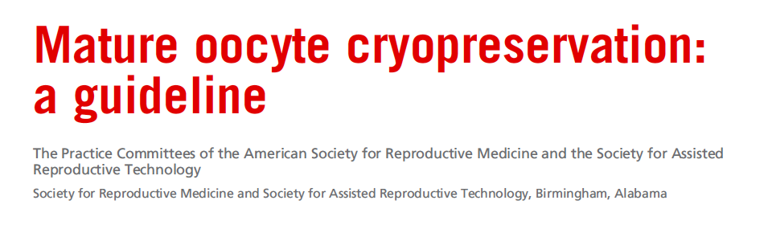

2012: “Oocyte cryopreservation should no longer be considered experimental”
“In patients facing infertility due to chemotherapy, oocyte cryopreservation is recommended with appropriate counseling”
Fertil Steril 2012
Notes:
By far the biggest achievement in reprodutive medinicine in th past 5 years is our abiliaty to freeze and thaw eggs. This has not only allow us to provide females the option of preserving their fertility without having a male partner.
Inddeed in 2012 the asrm finally declare that this si wod

Slide 10
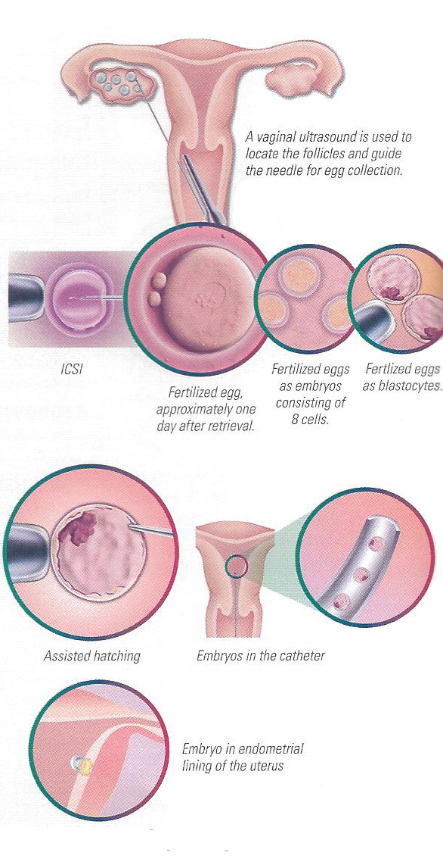
2 week process:
Injectable FSH, frequent monitoring, egg retrieval
Risks:
Ovarian Hyperstimulation
Delay in cancer tx
High estrogen levels
Thrombosis Risk
Bleeding Risk
Only possible in pubertal females
What is the process?
Embryo or Mature Oocyte Banking Require Ovarian Stimulation
Notes:
In order to bank embryos, it is necessary to stimulate the ovaries with gonadotropins after the menstrual period begins, ovulation is prevented with the use of either a gnrh agonist started in the preceeding cycle, or a gnrh antagonist. Intense monitoring by ultrasound and hormone tests is required and when the follicles are mature – usually after 8-14 days of stimulation – an egg retrieval is performed. Under sedation – tv us guidance is used to aspirate the flued from follicles- eggs come iwht the fluid.
The oocytes are exposed to sperm and the following day the fertilized eggs area usually frozen. Embryos can be frozen at different stages-
When a woman decides to use the embryos she may undergo a natural fet – monitoring her cycle and transferring embryos after ovulation or udergo a programmed fet – estrogen and progesterone is used to prim the uterine cavity and the et is performed

Slide 11
Letrozole + FSH Stimulation
Reduces Estradiol Levels
 | Letrozole 5 mg + FSH 150 IU N=47 | FSH 150 IU N=56 | P value
Age | 36 | 37 | 0.7
Peak Estradiol | 459 | 1453 | <0.001
Follicles >17mm | 4.0 | 2.6 | <0.001
Oocytes | 11.8 | 10.7 | 0.31
2 pronuclei (PN) | 6.3 | 6.6 | 0.65
Fertilization rate | 76% | 73% | 0.71
Total FSH | 1461 | 2355 | <0.001
Oktay et al. J Clin Endocrinol Metab, 2006.
Notes:
Letrozole is now used in conjuction with FSH by most programs to reduce estrogen levels in patients with estrogen sensitive tumors. 5mg is started prior to initiation of gonadropins and continued until the day of trigger. This slide shows data from th first stuyd published using this protocol showing that estrogen levels are much lower descpite similar numbers of oocyes and embryos obtained. It is important to recognize that follicle size should be bigger – at least 20 for trigger.

Slide 12
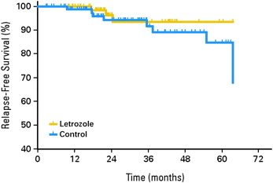
Relapse-free survival in women with breast cancer stimulated with letrozole/FSH versus controls
HR = 0.56, 95% CI 0.17-1.9
http://dx.doi.org/10.1016/j.fertnstert.2012.09.022
Azim AA et al., J Clin Oncol 2008;26:2.
Notes:
Follow up data from this study showed that there was no difference in relapse free survival in br cancer patients who underwent stimulation compated to those that did not.
These are the only data that exist looking at stimulation as a risk for relapse. No data exist in the brca population re stimulation

Slide 13
What About Ovarian Suppression Through Chemotherapy?
High rates of ovarian preservation observed compared to historical controls in women treated for hematologic malignancies
Results of randomized studies in breast cancer have been mixed and commonly used only return of menses as endpoint
Few data are available on pregnancy outcomes
Notes:
13

Slide 14
POEMS/S0230 Schema
Premenopausal Stage I, II, IIIA
ER-/PR- Breast Cancer
Under Age 50
Stratified by
age and
chemotherapy regimen
Randomization
Standard cyclophosphamide
containing (neo)adjuvant chemotherapy
Standard cyclophosphamide
containing (neo)adjuvant chemotherapy + goserelin
Moore et al, ASCO 2014, NEJM 2015

Slide 15
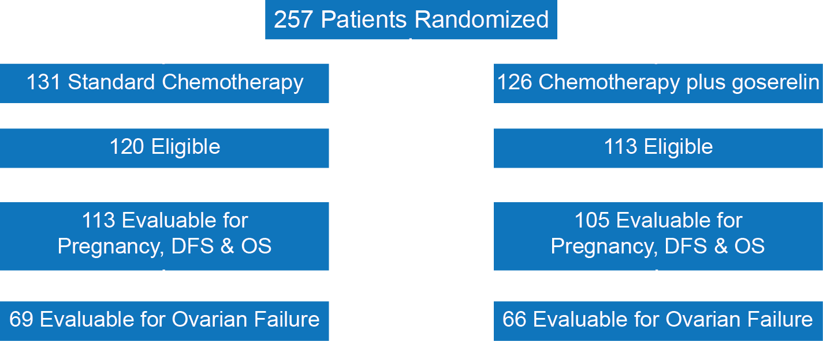
POEMS Consort Diagram
Moore et al, ASCO 2014, NEJM 2015

Slide 16
POEMS Ovarian Failure
 | Standard Chemotherapy | Chemotherapy + Goserelin
Ovarian failure at 2 years | 15/69 = 22% | 5/66 = 8%
Logistic Regression Results:
Analysis | Odds Ratio | 95% CI | p-value
 |  |  | One-sided | Two-sided
Univariate | 0.30 | 0.10 – 0.87 | p=.01 | p=.03
Stratified* | 0.30 | 0.09 – 0.97 | p=.02 | p=.04
Multivariate* | 0.36 | 0.11 – 1.14 | p=.04 | p=.08
*Accounting for age and regimen through stratification (“Stratified”)
or covariate (“Multivariate”) adjustment, respectively
Slide courtesy of H. Moore

Slide 17
POEMS Pregnancy
 | Standard Chemotherapy n=113 | Chemotherapy + Goserelin n=105 | Adjusted OR | Adjusted P-value
Attempted pregnancy | 18 (16%) | 25 (24%) |  | p=.12
Achieved pregnancy | 12 (11%) | 22 (21%) | 2.45 | p=.03
Patients with > 1 delivery Delivery or ongoing pregnancy | 8 (7%) 10 (9%) | 16 (15%) 19 (18%) | 2.51 2.45 | p=.05 p=.04
Total number of babies Ongoing pregnancies Total adverse events Miscarriages Elective termination Delivery complication | 12 3 5 3 2 | 18 5 4 2 2
Slide courtesy of H. Moore

Slide 18
Ovarian Suppression Through Treatment: 9 RCTs
Meta-analysis planned
No hint of a safety problem
Reasonable to consider as an additional option for preservation of menstrual functioning and fertility
Adapted from N. Turner et al., Ann Oncol 2013
Notes:
No one can read this….if that is ok, then show it.
You could also summarize on a slide with a small number of bullets

Slide 19
Risks of fertility preservation
Risk of procedures themselves
  Unclear if letrozole or tamoxifen stimulation protocols for ovarian stimulation actually mitigate risks, for ER positive disease
Risk of remaining premenopausal
  IBCSG/NSABP B30 data
  SOFT results for very young women
Risk of pregnancy
Notes:
And, compounding all of these concerns both at diagnosis and f/u, if a woman is able to become pregnant, is the uncertainty of whether Pregnancy after breast cancer is safe?
READ SLIDE

Slide 20
DFS in women with pregnancy after ER+ breast cancer
Median follow-up from date of conception: 4.7 years (IQR: 3.1 – 6.9)
HR: 0.91; 95% CI (0.67 – 1.24); p=0.55
Date of conception
Total number of patients: 686
Total number of events: 199 (29%)
Azim H. et al; JCO 2012
Notes:
20

Slide 21





Pregnancy Outcome and Safety of Interrupting Therapy for women with endocrine responsIVE Breast Cancer
IBCSG 48-14 / BIG 8-13
ALLIANCE # A221405
POSITIVE TRIAL
International PI: Olivia Pagani
North American PI: Ann Partridge

Slide 22
The POSITIVE Trial: Endocrine therapy interruption for pregnancy in breast cancer patients
  Phase II trial designed to evaluate safety and pregnancy outcomes of interrupting ET for young women with ER+ disease who desire pregnancy
  Enroll 512 women, <42, premenopausal, have completed between 18-30 months of ET
  Study participants come off endocrine therapy for up to 2 years for a pregnancy attempt, restart hormonal therapy
  Outcomes: disease, reproductive, psychosocial

Slide 23
Conclusions
Fertility after breast cancer is an important consideration for a substantial proportion of young women at diagnosis and in survivorship
Attention and appropriate referrals and support surrounding this issue may be necessary in order to optimize medical and psychosocial outcomes

Slide 24
THANK YOU!

