Slide 2
Castration Sensitive Prostate Cancer
CHAARTED (DOCETAXEL) versus LATITUDE (ABIRATERONE)
Christopher Sweeney, MBBS
Medical Oncologist, Dana Farber Cancer Institute
Associate Professor, Harvard Medical School

Slide 3
But “first things first”
When choosing between docetaxel and abiraterone
  First ask is the patient “fit for docetaxel”
  Second does the patient have a high enough burden of disease to potentially benefit from docetaxel

Slide 4
Current mHSPC Datasets in One Slide
Trial | M1 pt subgps | All M1 | High vol. / Poor risk | Low vol. | Median Follow-up (months)
GETUG15 | HV & LV | HR: 0.88 (NS) | HR: 0.78 (NS) | HR: 1.02 | 84
CHAARTED | HV & LV | HR: 0.73 | HR: 0.63 | HR 1.04 | 53.7
STAMPEDE-Doc | Any M1 (no subgroups) | HR: 0.76 | N/A | N/A | 43
LATITUDE | Poor risk only | N/A | HR: 0.62 | Not included | 30.4
STAMPEDE-Abi | Any M1 (no subgroups) | HR: 0.63 | N/A | N/A | 40
Gravis et al Eur Uriol 2016; Sweeney et al ESMO 2016; James et al Lancet 2015; Fizazi et al NEJM 20157 James et al NEJM 2017

Slide 5
Interesting observations of the
ADT + docetaxel trials
GETUG15 was conducted in an era when less access to life prolonging CRPC therapies than CHAARTED and STAMPEDE-Doc
Long term follow-up of CHAARTED shows HR lessens with time as the effect was less pronounced in low volume patients
Test for heterogeneity for impact from docetaxel
  M1 High volume vs low volume: differential effect seen within CHAARTED and in aggregate with GETUG 15;
    Overall CHAARTED and GETUG15 are “homogeneous”
  M0 vs M1: STAMPEDE docetaxel: my presumption is [HV M1] and [high risk M0 treated with ADT+doc] benefit
    and not enough granularity to look at the indolent M0 biochem relapse and low volume M1

Slide 6
Does volume matter for upfront chemotherapy for castration naïve metastatic prostate cancer?
The answer is “YES” if you consider prostate cancer is a disease that
  1) is biologically heterogeneous
  2) is clinically heterogeneous
  3) requires individual treatment plans

Slide 7
Reproducibility of 0, 1, 2 risk factors for mHSPC:
GETUG15 and CHAARTED
On ADT alone
  Patients with high volume disease have a poorer outcome than low volume
    High volume is 1 risk factor
  Patients with de novo metastatic disease have a poorer outcome than those who relapse after local therapy
    De Novo metastatic disease is 1 risk factor
  What is OS if have 0 or 1 or 2 risk factors?
    Time and volume of metastases = destiny

Slide 8
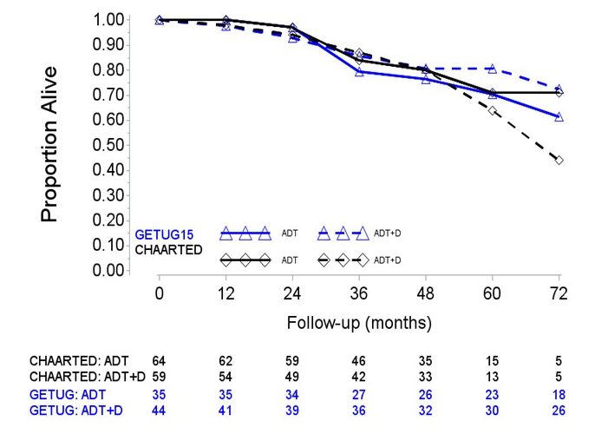
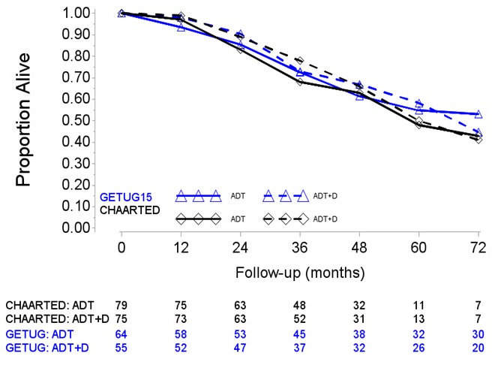
OVERALL SURVIVAL:
1 or 0 risk factors: low volume
Low Volume and Prior Local Therapy | Low Volume and De Novo Mets
Median OS ADT: ~ 8 yrs | Median OS ADT: ~ 5 yrs
Gravis et al GUASCO 2017

Slide 9
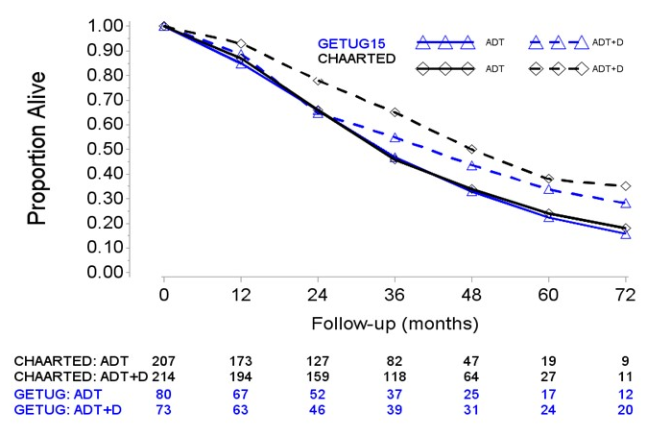
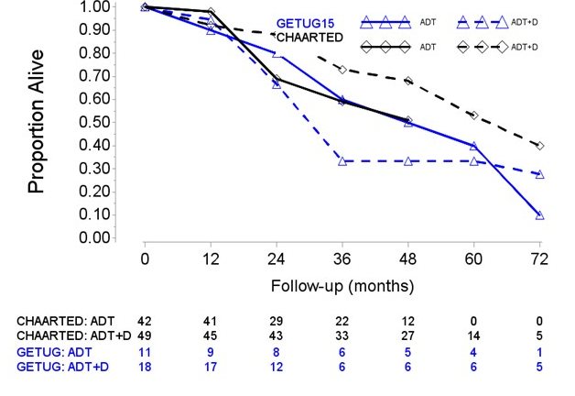
OVERALL SURVIVAL:
1 or 2 risk factors: High volume
High Volume and Prior Local Therapy | High Volume and De Novo Mets
Median OS ADT: ~ 4.5 yrs | Median OS ADT: ~ 3 yrs
Gravis et al GUASCO2017

Slide 10
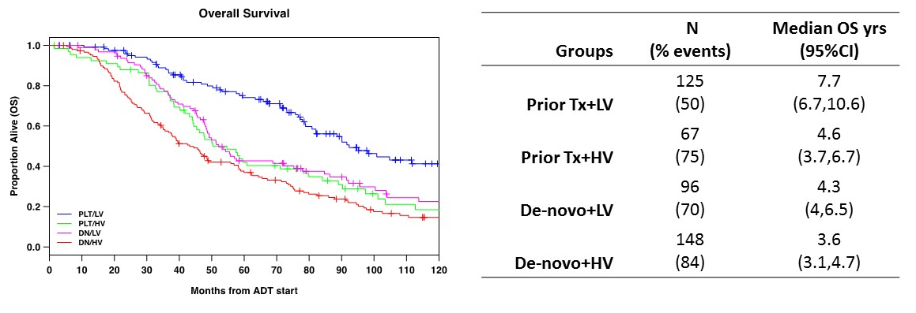
Reproducibility in a Hospital-based Registry: DFCI
Francini et al GUASCO 2017

Slide 11
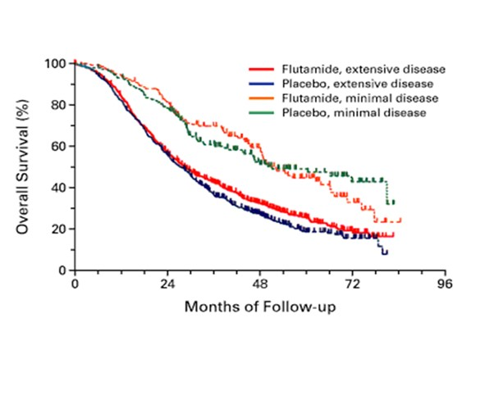
Reproducibility over the ages
SWOG S8894 - Bilateral orchiectomy ± flutamide
Median OS
(orchidectomy arm)
Metastatic burden:
“minimal”: 51 mo
“Extensive”: 27.5 mo
Extensive: appendicular skeletal involvement (± axial skeletal involvement), visceral (lung or liver) metastases or both
Eisenberger M et al. N Engl J Med 1998;339:1036-42

Slide 12
A Brief Word on PSMA PET Imaging
Conventional imaging with CT A/P and bone scan is boring, old school, gold standard … like a gold nugget from a stream … it has mud on it
  But ... If we had a serum blood test or new imaging that was as prognostic for OS as CT A/P and Tc bone scan
  • NEJM, Nature Paper
  • Press releases: “Biomarker heralds the future”
Can ANYONE tell me the clinical significance of a patient with 2 bone mets on bone scan but diffuse bone mets on PSMA PET positive?
May have a role in guidance for SBRT for biochemical recurrence when conventional scan is negative

Slide 13
Evidence That Volume Impacts
Efficacy of Docetaxel
Clinical outcomes
Statistics
“Curvology”
Treatment burden

Slide 14
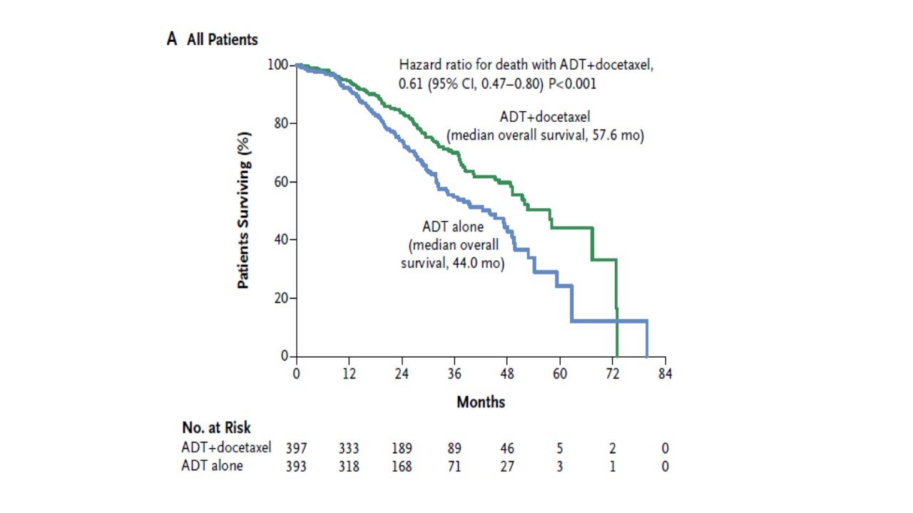
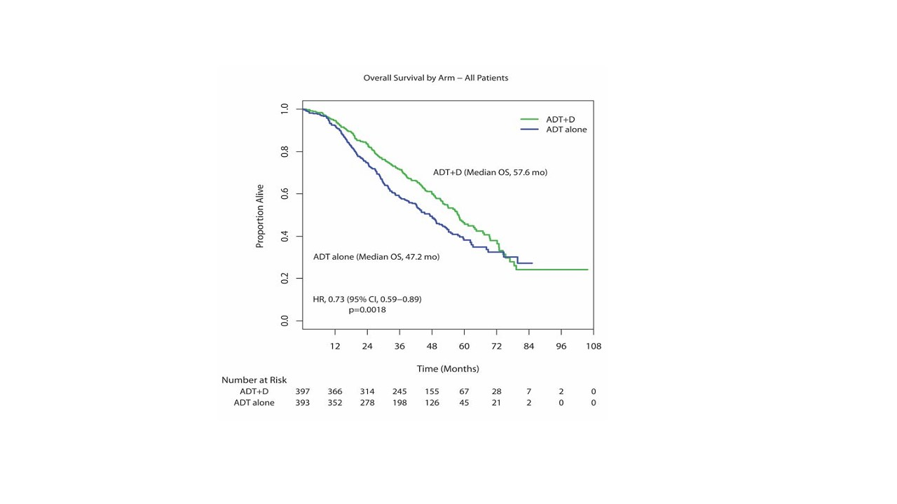
What are we learning from long term follow-up of CHAARTED: Overall Population
Median Follow-up
28.9 months
Median Follow-up: 53.7 months
13 months / HR 0.61
10 months / HR 0.73
Sweeney et al NEJM 2015, Sweeney et al ESMO 2016

Slide 15
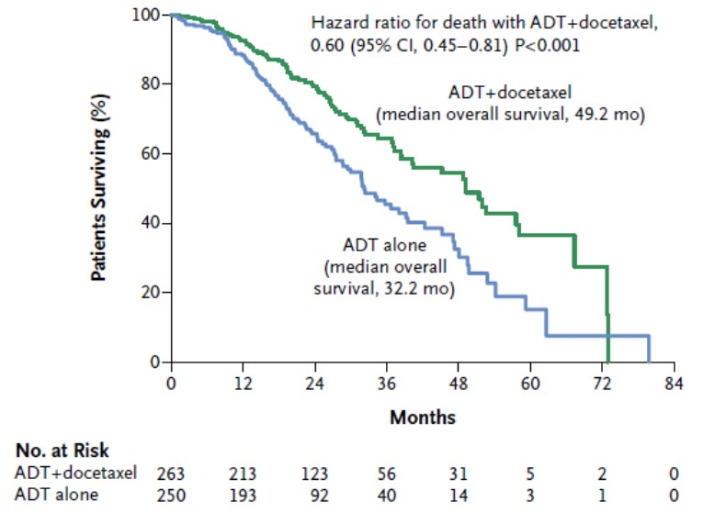
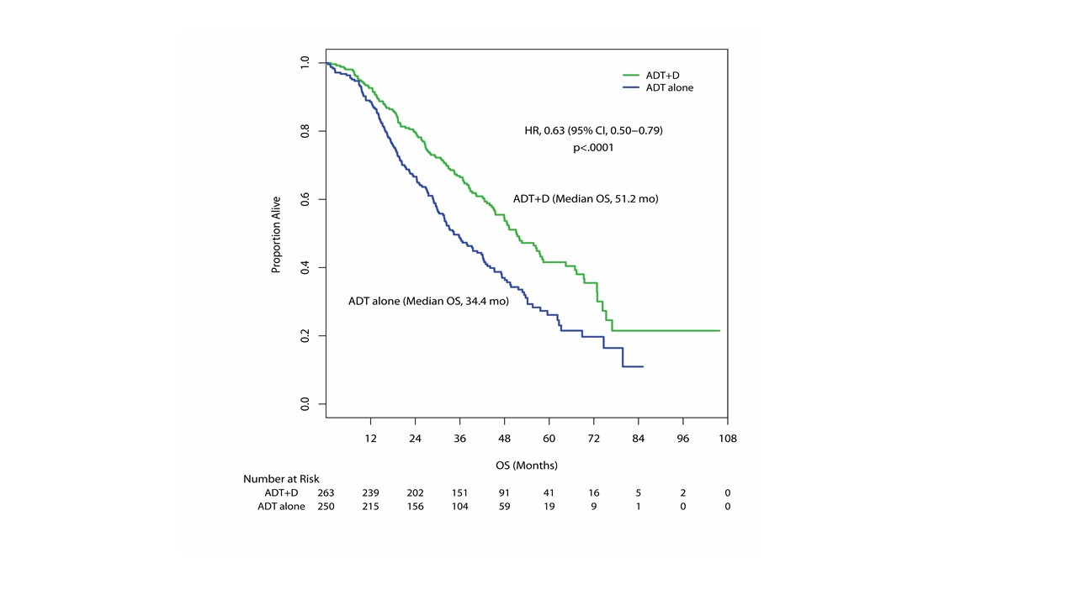
What are we learning from long term follow-up of CHAARTED: High volume
Median Follow-up
28.9 months
Median Follow-up: 53.7 months
17 months / HR 0.6
17 months / HR 0.6
Sweeney et al NEJM 2015, Sweeney et al ESMO 2016

Slide 16
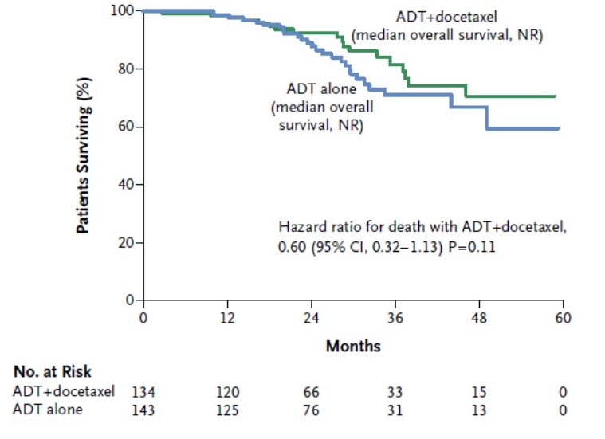
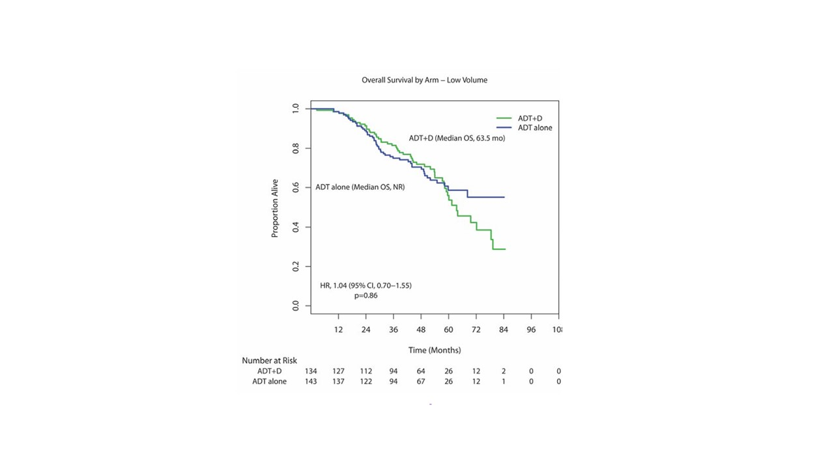
What are we learning from long term follow-up of CHAARTED: Low volume
Median Follow-up
28.9 months
Median Follow-up: 53.7 months
NR / HR 0.6
0 months / HR 1.0
(few low volume pts have aggressive disease and benefit from early docetaxel?)
Sweeney et al NEJM 2015, Sweeney et al ESMO 2016

Slide 17
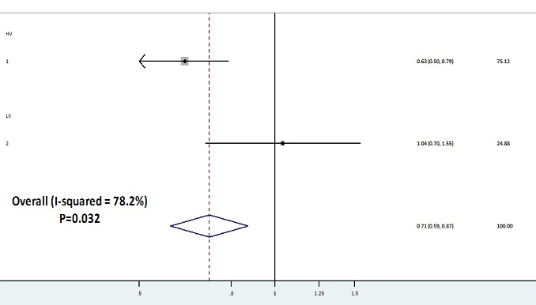
What are we learning from long term follow-up of CHAARTED: Test for Heterogeneity
High
volume
HR Weight
0.63 75.12
1.04 24.88
0.71 100
Low
volume
With long term follow-up low volume and high volume had a differential effect with early docetaxel
Under review with data from Sweeney et al ESMO 2016

Slide 18
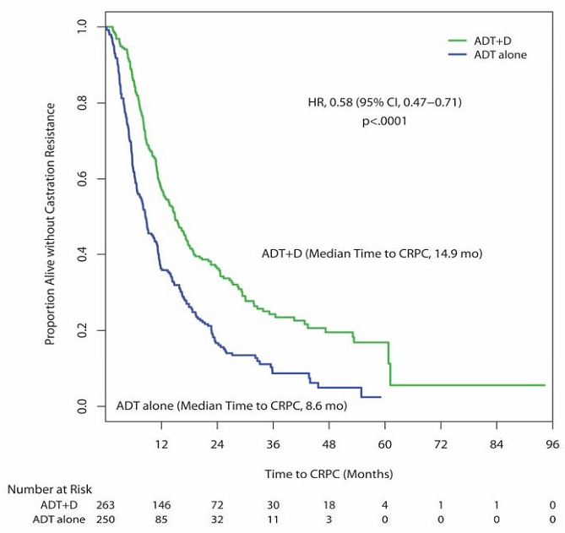
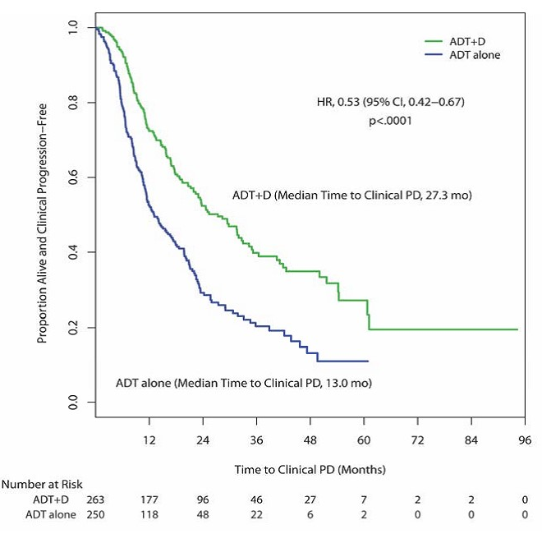
Time to CRPC and Time to Clinical PD: High volume
Time to CRPC /PSA rise
HR (0.58)
Time to Clin PD
HR (0.53)
Time to CRPC / PSA rise with HR (0.58) than time to HR for time to Clin PD (0.53)
Does the early docetaxel help make therapies at time of PSA rise more effective in high vol and hence a more impressive HR of 0.58?
Sweeney et al NEJM 2015, Sweeney et al ESMO 2016

Slide 19
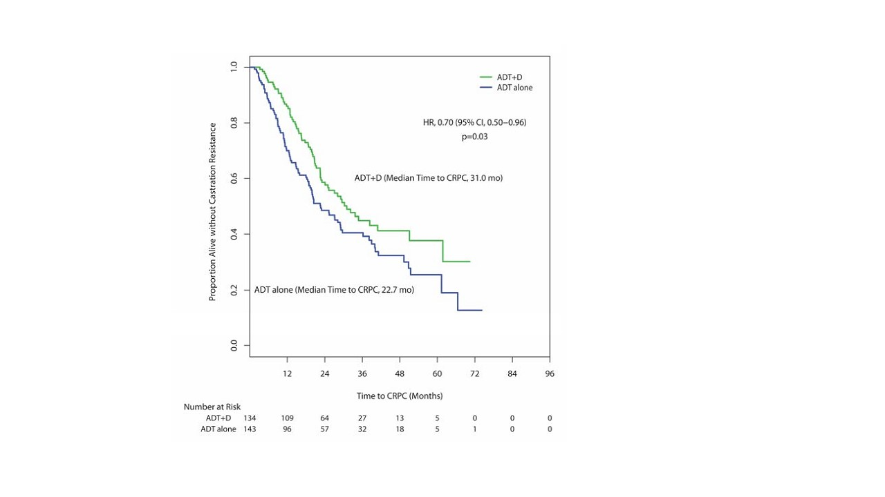
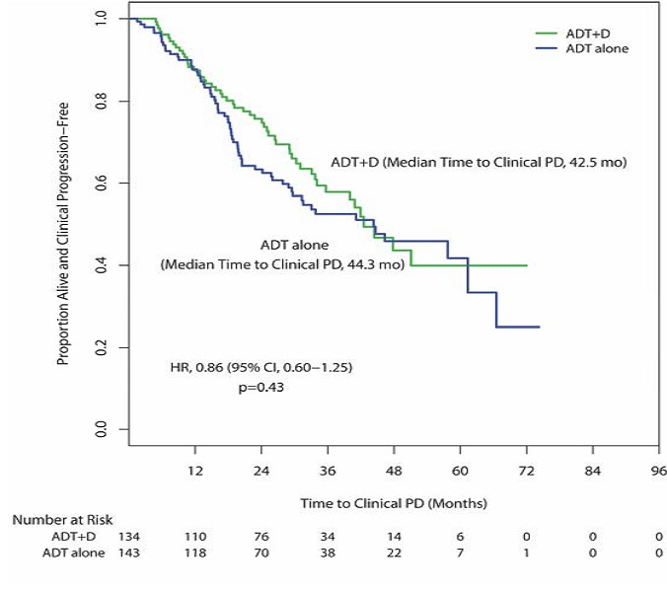
Time to CRPC and Time to Clinical PD
Low volume
Time to CRPC /PSA rise
HR (0.70)
Time to Clin PD
HR (0.86)
Time to CRPC (HR: 0.70) is better than HR (0.86) for time to clinical PD
Are patients with low volume more able to be salvaged than HV?
Sweeney et al NEJM 2015, Sweeney et al ESMO 2016

Slide 20
“Curvology” of the Low volume KM curve
Median Follow-up: 53.7 months
Pre-specified subgroup
  ADT alone arm OS was as expected and detailed in protocol stats section of E3805
100 deaths of 277 pts
  HR 1.04
  Identical to LV GETUG
Yes … it was not an a priori powered subgroup
But … who would ever take a randomized phase 2 trial result like this to a phase 3 trial?
Sweeney et al ESMO 2016; Gravi et al Eur Urol

Slide 21
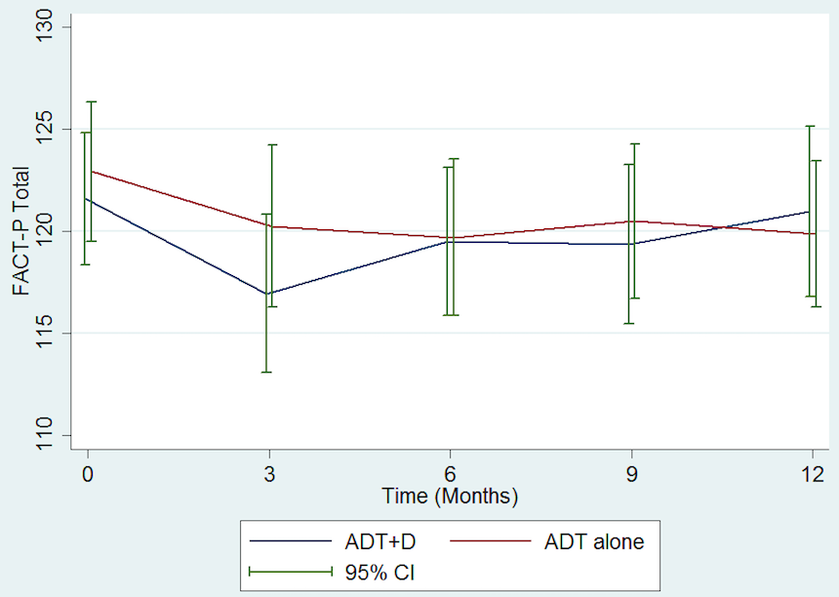
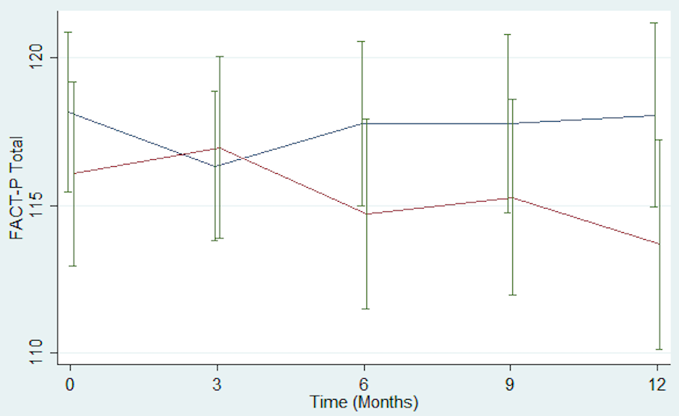
QOL FACT-P: CHAARTED
Low Volume
High Volume
ADT alone (red curves) in low volume had no change in QOL over 12 months in low volume but decline in high volume (progression of disease – symptoms and progression)
ADT plus docetaxel (blue curves) decline in QOL in low vol on chemo
But no decline and better 12 month QOL in high volume

Slide 22
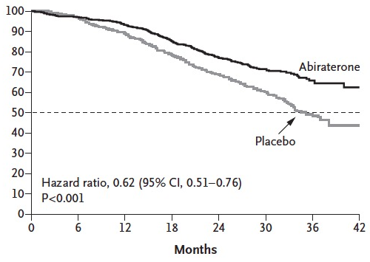
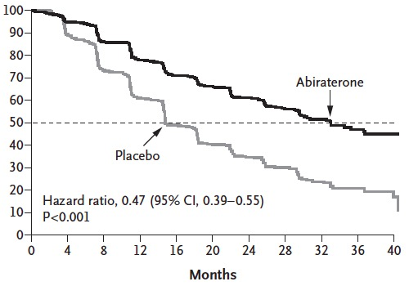
LATITUDE: ADT +/- Abi in “poor risk” mHSPC
Clinical efficacy results
(poor risk: de novo, >2 bone mets, Gl > 8, visceral mets)
OS
rPFS
ADT + Abi
OS NR
ADT + Abi
PFS 33.0mo
OS Rate at 3 years
ADT + Abi: 66%
ADT: 49%
ADT
OS 34.7mo
ADT
PFS 14.8mo
HR 0.62 (95% CI, 0.51-0.76)
P<0.001
HR 0.47 (95% CI, 0.39-0.55)
P<0.001
Statistically significant 38% risk reduction of death
Statistically significant 53% risk reduction of rPFS or death
Median follow-up: 30.4 months
1. Fizazi et al. ASCO 2017; 2. Fizazi et al. NEJM 2017

Slide 23
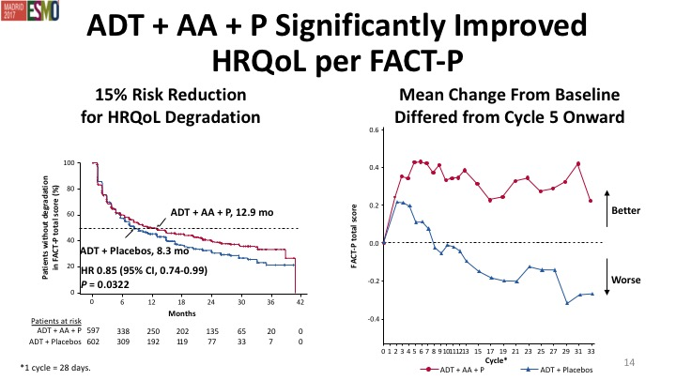
LATITUDE: QOL results
Chi et al ESMO 2017

Slide 24
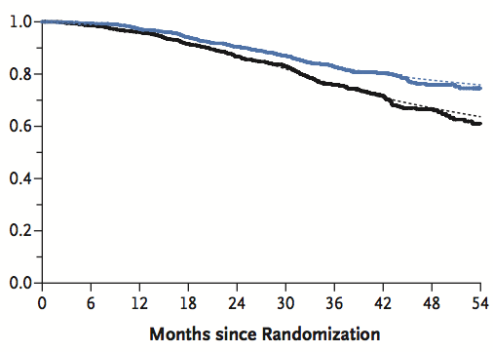
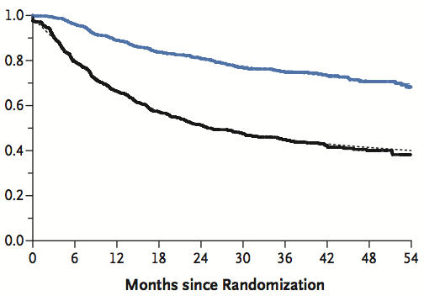
STAMPEDE-abi M1 group: clinical efficacy results
(Any M1: not detail low and high volume)
OS
FFS
ADT + abi: NR
ADT + abi: NR
ADT: NR
3-year OS rate
ADT + Abi: 83%
ADT: 76%
ADT: NR
HR 0.63 (95% CI, 0.52–0.76)
P<0.001
HR 0.29 (95% CI, 0.25–0.34)
P<0.001
Statistically significant 37% risk reduction of death
Statistically significant 71% improvement in time to failure
Efficacy data from STAMPEDE was highly concordant with LATITUDE
Median follow-up: 40 months
1. James et al. ASCO 2017; 2. James et al. NEJM 2017

Slide 25
Grade 3–5 AEs in ≥2% of patients
 | CHAARTED¹ |  |  | LATITUDE² |  | STAMPED ARM G³
 | ADT + Docetaxel (n=390) |  |  | ADT + Abiraterone (n=597) |  | ADT + Abiraterone (n=948)
AE, % | Grade 3 | Grade 4 | Grade 5 | Grade 3 | Grade 4 | Grade 3–5
Allergic reaction | 1.8 | 0.3 | 0 | – | – | –
Fatigue | 4.1 | 0 | 0 | 2 | 0 | 2
Neutropenia | 3.1 | 9.0 | 0 | – | – | –
Febrile neutropenia | 3.8 | 2.3 | 0 | – | – | –
Pulmonary disorder | – | – | 0.3 | – | – | –
Hypertension | – | – | – | 20 | 0 | 1
Hypokalaemia | – | – | – | 10 | 1 | <1
ALT increased | – | – | – | 5 | <1 | <1
Hyperglycaemia | – | – | – | 4 | <1 | –
AST increased | – | – | – | 4 | <1 | <1
Bone pain | – | – | – | 3 | 0 | –
Cardiac disorder | – | – | – | 3 | 1 | 10
Endocrine disorder | – | – | – | – | – | 14
Gastrointestinal disorder | – | – | – | – | – | 5
General disorder | – | – | – | – | – | 5
The overall safety profile of ADT + abiraterone was consistent with prior studies in mCRPC and favorable in both STAMPEDE and LATITUDE
1. Sweeney et al. N Engl J Med 2015; 2. Fizazi et al. NEJM 2017; 3. James et al. NEJM 2017

Slide 26
Brief synopsis of what we know about LATITUDE and STAMPEDE-abi
The ADT alone arm for LATITUDE had median OS of about 3 years
  This is similar to OS of high volume patients in CHAARTED
  LATITUDE patients were by definition “high volume de novo metastatic”
    Newly diagnosed and had poor risk factors
  Most likely STAMPEDE-abi were also most likely high volume but not annotated volume of disease
    ADT alone M1 arm: same median OS of ~44 months – same as overall OS for CHAARTED and STAMPEDE-doc
    95% were de novo metastatic of which most are high volume
    Early OS signal in STAMPEDE-abi probably driven by M1 high volume HSPC

Slide 27
Brief synopsis of what we know about LATITUDE and STAMPEDE-abi
So … the patients on the control arm of both arms with ADT alone had events quickly like CHAARTED high volume pts and early results of STAMPEDE-abi and LATITUDE with HR(OS) of 0.6 is because impacting the poor prognostic group
We really do not have a data-set to comment on whether upfront combination ADT plus abiraterone is better than sequential ADT and then abiraterone in low volume / oligometastatic disease patients

Slide 28
Brief synopsis of what we know about LATITUDE and STAMPEDE-abi
Based on a lower treatment burden I suspect higher use of abiraterone in low volume mHSPC than docetaxel
  But … do we know the risk:benefit analysis
  Potential issues of long term >5 yrs of abi and daily pred
    Vs sequential approach
    Vs intermittent approach
    Vs add on if ADT alone effect minimal / waning on intermittent ADT.

Slide 29
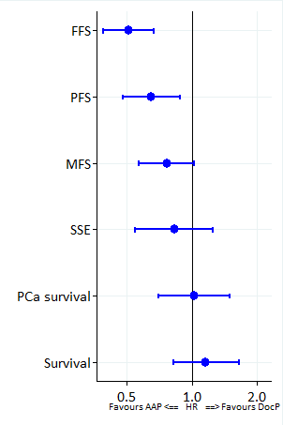
STAMPEDE
ADT + Doc vs ADT + Abi
Favours
SOC+AAP
Favours
SOC+DocP
Failure-free
survival
Head-to-head data in 566 pts (Nov-2011 to Mar-2013)
Progression-free survival
Strong evidence favouring AAP
Metastatic
progression-free survival
Weak evidence favouring AAP
Symptomatic skeletal events
No good evidence of a difference
Cause-specific
survival
→ “Proportionately different time spent in each disease state”
Overall survival
Hazard ratio
Sydes et al ESMO 2017
Notes:
Survival similar which means spending time in proportionately different disease states

Slide 30
ADT plus docetaxel vs ADT plus abiraterone
Sydes et al ESMO 2017
  Opportunistic look when pts were accrued to either arm of MAMS STAMPEDE design
Abiraterone prevented PSA rise for longer (not unexpected) than docetaxel
Docetaxel followed by subsequent therapy same OS as Abiraterone followed by subsequent therapy
Suggests: drugs working on different clones

Slide 31
Network meta-analyses suggest “abiraterone” better
These indirect comparisons are inherently limited by the fact
  Docetaxel is handicapped by including a study (GETUG15) completed in an era with limited access to
  Abiraterone had an inherent positive bias by having greater proportion of patients with ”poor risk” patients with a clear treatment effect and short follow-up
    It could be better prognosis patients may dilute the effect with longer follow-up
STOPCaP, ESMO 2017

Slide 32
It takes two to tango ….
GETUG15 suggests if not get both docetaxel and life prolonging CRPC therapies: no clear OS benefit with upfront docetaxel
STAMPEDE suggests abiraterone and docetaxel are as good as each other
presumably given trial conducted in UK, Switzerland, Ireland there was as much access to Abi as there was to docetaxel at CRPC

Slide 33
Despite early docetaxel and abiraterone there is still 20% of patients dying by 24 months
CHAARTED: HV
LATITITUDE
STAMPEDE-Abi M1

Slide 34
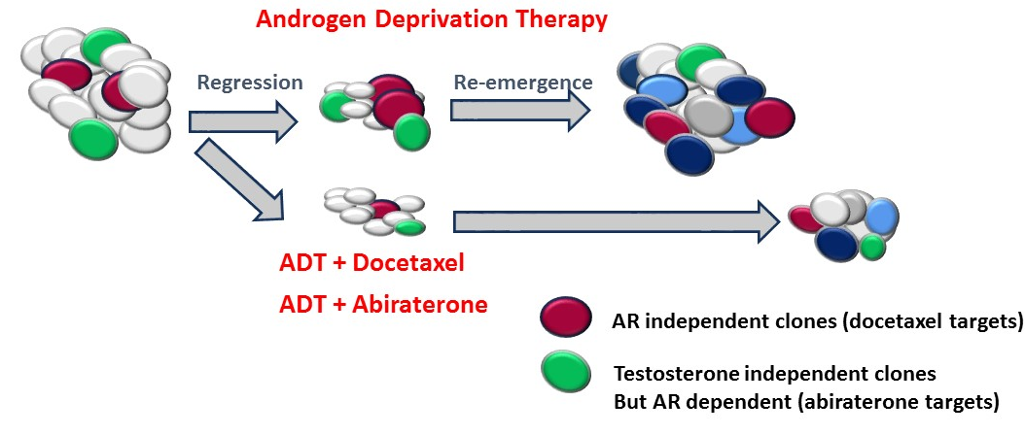
    CHAARTED/GETUG/STAMPEDE/LATITUDE:
    ADT plus docetaxel or abiraterone
    Hypothesis: early targeting of two types early testo independent cells – [AR+] or [AR-] clones lead to benefit with ADT + abiraterone or ADT plus docetaxel respectively

Slide 35
  Triplet vs Doublet [ADT + D] vs [ADT + D + Enza or Abi]
  Will combining the data from trials that stratified by doceaxel use and will report “soonish” be informative enough?
 | ENZAMET | PEACE-1* | Combined
Overall | N | N | N
ADT+D | 252 | 290 | 542
ADT+Doc + Enz /Abi | 252 | 290 | 542
High Volume
ADT+D | 180 | 232 | 412
ADT+D+E/A | 180 | 232 | 412
* Recognizing even distribution of radiation to the prostate ~ 50% in each group and estimating 80% of de novo metastatic have high volume disease
Plus: Some patients from STAMPEDE and TITAN (ADT +/- apalutamide)

Slide 36
ENZAMET may provide some guidance on role of new generation anti-AR therapy in mHSPC (HV and LV)
Eligibility
Metastatic prostate cancer
Adequate organ function
Starting 1st line ADT
Stratification
Volume of disease
Anti-resorptive therapy
Comorbidities
Study Site
Docetaxel use
Enzalutamide 160mg/daily
+ LHRHA (or orchidectomy)
until progression
Endpoints
Overall survival (primary)
PSA progression free survival
Clinical progression free survival
Health related quality of life
Adverse events
Incremental cost-effectiveness
R
1:1
Non-Steroidal Anti-Androgen*
+ LHRHA (or orchidectomy)
until progression
1,125 participants (March 2017)
CHAARTED Definition:
N=533 with Low volume: ~ 30% with docetazel
N=592 with High volume: ~60% with docetaxel

Slide 37
Cost of early docetaxel vs abiraterone
If you had to manage your pharmacy budget for GU Oncology for mHSPC 100 pts
Uprfront Docetaxel 6 cycles: visits + infusion + cost of drug: $10,000
  Plus add-on abiraterone for rising PSA at $8,000 per month in USA
  Median time to progression: 18 months = $144,000 for one person
  ~$15 million to treat 100 patients
Upfront abiraterone median time to progression: 36 months
  [$8K x 36 months x 100 pts] + [$10K x 100] = ~$30 million to treat 100 pts
And have to leave some money in the budget for immuno-onc drugs for urothelial and kidney cancer

Slide 38
OK … That is all very nice … But answer the question!
In 2017 … in Brazil ….
Should I use ADT plus docetaxel
  Or
Should I used ADT plus abiraterone

Slide 39
OK … That is all very nice … But answer the question!
It is “unfashionable” to propose the more “toxic” chemotherapy but for the patient with high volume disease and fit for chemotherapy
Docetaxel has more short term adverse events and done in 18 weeks
  Abiraterone is more “insidious” for some .. Esp where blood sugar control and tenuous cardiac and fluid volume status
  Abiraterone more clinic visits
Reasons: get docetaxel in before too frail
  Abiraterone can be added on later more easily if more frail
  Aim is to get as many therapies in as possible
  “One-shot, One opportunity”
Less overall long term treatment and cost burden
  With similar OS efficacy
We may learn soon which patients benefit from “triplet” therapy

Slide 40
OK … That is all very nice … But answer the question!
It is “unfashionable” to propose the more “toxic” chemotherapy but for the patient with high volume disease and fit for chemotherapy
Docetaxel has more short term adverse events and done in 18 weeks
  Abiraterone is more “insidious” for some .. Esp where blood sugar control and tenuous cardiac and fluid volume status
  Abiraterone more clinic visits
Reasons: get docetaxel in before too frail
  Abiraterone can be added on later more easily if more frail
  Aim is to get as many therapies in as possible
  “One-shot, One opportunity”
Less overall long term treatment and cost burden
  With similar OS efficacy

Slide 41
OK … That is all very nice … But answer the question!
It is “unfashionable” to propose the more “toxic” chemotherapy but for the patient with high volume disease and fit for chemotherapy
We may learn soon which patients benefit from “triplet” therapy
We may learn from biomarker work which pts benefit from docetaxel
Let’s not throw the baby out with the bath water just because a new agent with a heavy marketing campaign came to town

Slide 42
Movember foundation
….. is why I have the “Mo’
MOVEMBER’S VISION:
To have an everlasting impact on the face of Men’s Health
3 cause areas:
Prostate Cancer
Testicular Cancer
Mental Health and Suicide Prevention
Team Bellissimo: https://moteam.co/bellissimo?mc=1
https://mobro.co/christophersweeney?mc=5

