Slide 2
Management of the Axilla after Neoadjuvant Chemotherapy
Tari King, MD
Chief, Breast Surgery, Dana-Farber/Brigham and Women’s Cancer Center
Associate Chair for Multidisciplinary Oncology
Department of Surgery, Brigham and Women’s Hospital
Anne E. Dyson Associate Professor of Surgery,
Harvard Medical School

Slide 3
No Disclosures

Slide 4
Neoadjuvant Therapy
No survival advantage or disadvantage
Degree of pathologic response correlates with both DFS and OS
Subtype dependent
Allows down-staging of disease
BCT in select patients with large tumors
reduces need for axillary node dissection
Requires a multi-disciplinary approach….
Notes:
Accepted facts about NAC - No survival advantage or disadvantage compared to similar tx given in the adjuvant setting
Degree of pathologic response correlates with both DFS and OS
Allows down-staging of disease
large tumors and BCT in select patients
reduces need for axillary node dissection
Requires a multi-disciplinary approach….

Slide 5
Neoadjuvant Therapy and Survival
~1500pts, AC
~2300 pts, AC/T
Rastogi P et al. J Clin Oncol 2008;26:778-785
Notes:
Quick review of some of the data supporting these statements: Two of the landmark trials that established no survival advantage or disadvantage … NSABP B-18 which randomized 1500 pts to preop or post op AC and B27 which added a taxane either preoperatively or postoperatively… both trials enrolled pts with operable breast cancer and demonstrated no difference in OS or DFS. We did learn that patients with a good response did better than patients lesser degrees of response.. And as you will see throughout this talk these two trials have provided us with a wealth of information about the neoadj approach.
1988 -1993: 1523 pts with operable breast ca.
Tumor shrinkage 79% pts (36% cCR and 43% cPR)
9 year results: OS 69% preop vs 70% postop
DFS 55% preop vs 53% postop

Slide 6
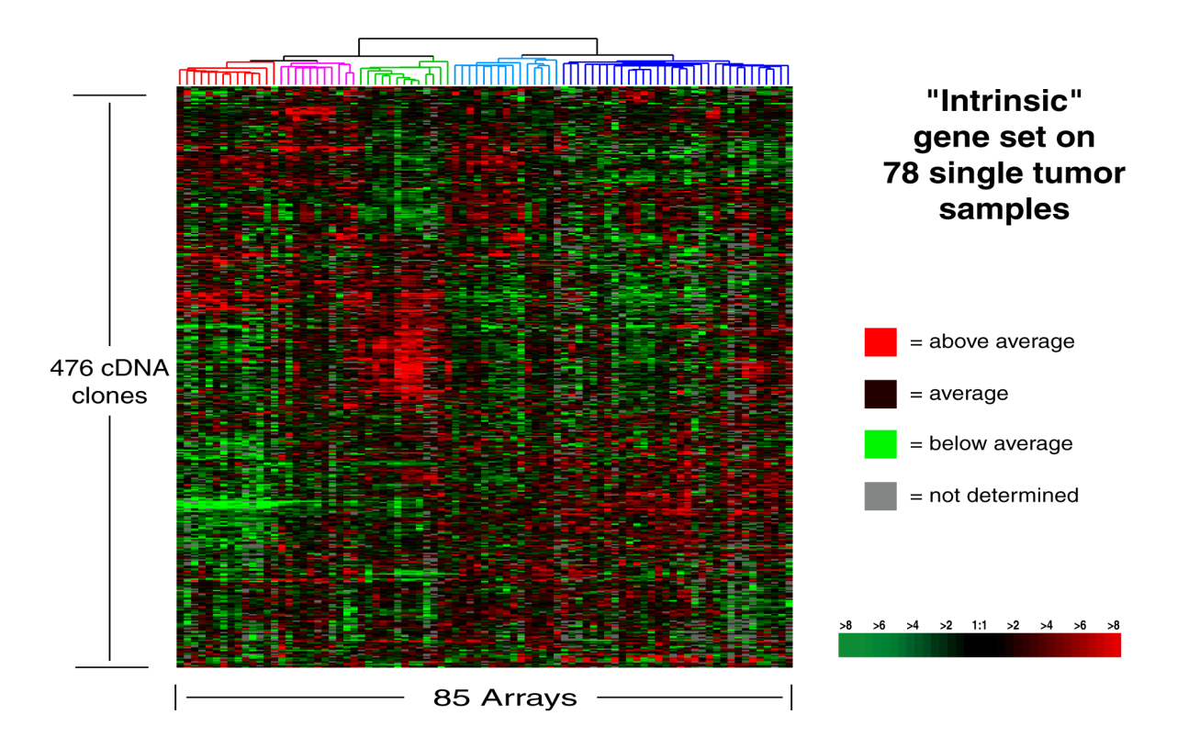
Molecular Portrait of Breast Cancers
Basal-like
HER-2
“Normal”
Luminal B
Luminal A
Sorlie T, Proc Natl Acad Sci USA 2001;98:10869
Notes:
These trials were run before we appreciated the different molecular subtypes of breast cancer – the luminal groups: represented by the ER+ groups, the basal like which is primarily represented by TNBC and the Her2 enriched subtype…

Slide 7
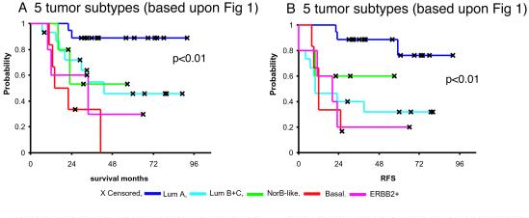
DFS and OS by Subtype
Sorlie T, Proc Natl Acad Sci USA 2001;98:10869
Notes:
And we now recognize that these subtypes are associated with vast differences in DFS and OS with standard chemotherapy
Shown here with the luminal A group having the best prognosis and the Her2 and TNBC having the worst prognosis but this was before the routine use of taxanes and antiHer2 therapy

Slide 8
pCR and LRR by subtype NAC and BCT
Single institution series 751 pts, 2005-2012 MDACC
Notes:
These subtypes are also associated with different responses to NAC – shown here in this dataset of 751 pts treated between 2005 and 2012 at MDACC– everyone received preop taxane and Her 2+ received trastuzumab – we see rates of pCR vary from a low of 16% in the HR+ Her2- pts to over 70% in the HR- Her2+ subset – and we see the difference in outcomes (shown here is LRR) by pCR status – achieving a pCR is associated with excellent outcomes in all groups, yet not achieving a pCR is associated with bigger differences in outcomes in patients with the more aggressive subtypes..…

Slide 9
MSKCC Neoadjuvant Therapy nodal pCR by subtype
Clinical Stage I-III breast cancer, enrollment 11/2013-7/2015
245/440 pts had completed surgical therapy
 | N = 245 cN0 and N1 | % pCR breast and axilla* |  | N =133 cN1 | % pCR axilla
ALL | 74 pts | 30% |  | 65 pts | 49%
ER+/HER 2- | 7 | 9% |  | 12 | 23%
ER+/HER2+ | 33 | 50% |  | 20 | 74%
ER-/HER2+ | 17 | 63% |  | 16 | 89%
ER-/HER2- | 17 | 24% |  | 17 | 47%
*No residual invasive or in situ disease in breast and axilla;
includes patients that were initially cN0
Notes:
Today we supposed to be focusing on the axilla – these data are a snapshot from the MSKCC database that we started before I left demonstrating again that rates of achieving a pCR in the axilla also varies by subtype
Again opening up the potential to avoid ALND in these patients…

Slide 10
Axillary Management Neoadjuvant Therapy
NAC downstages axilla ~ 40% of patients
Potential to consider SLNB after NAC – avoid ALND
Should management depend on pre-treatment clinical node stage?
Notes:
Shifting gears to the axilla - Over the last decade it has become increasingly clear that NAC also downstages the axilla with reports of pCR averaging around 40% and we know that the response in the axilla varies by tumor subtype just as it does in the breast
As we look to decrease the morbidity of surgical treatment for breast cancer patients there has been great enthusiasm to use SLN to stage the axilla after NAC thus affording patients the potential to avoid ALND
The most recent challenge is to determine whether management should differ by pre-treatment nodal stage

Slide 11
Axillary Node Downstaging NSABP B18
 | Surgery first (n = 743) | Chemo first (n = 735)
Overall node + | 57% | 41%
1-3 nodes + | 30% | 24%
4-9 nodes + | 17% | 12%
> 10 nodes + | 10% | 4%
 |  | p < 0.001
Can we do SLN biopsy after NAC and avoid ALND ?
Notes:
Going back to the beginning it was in NSABP B18 – the prospective RCT of preop vs postop chemotherapy that gave us the first insight that preop chemotherapy may be useful for downstaging the axilla – in patients having surgery first 57% had positive nodes as compared to 41% in those having chemo first. This downstaging effect was seen across all categories of nodal staging. Raising the question

Slide 12
SNB Before Neoadjuvant Therapy Arguments in Favor
Need information on the status of SLN without the confounding effects of neoadjuvant therapy
Further surgical management of the axilla
Selection of optimal local-regional XRT
Limited information on axillary recurrence rates with SLN after NAC
Notes:
There were some that argued against this approach stating that….
Need information on the status of SLN without the confounding effects of neoadjuvant therapy
Further surgical management of the axilla
Selection of optimal local-regional XRT
Limited information on axillary recurrence rates

Slide 13
SNB Before Neoadjuvant Therapy Disadvantages
Requires two surgical procedures
Does not take advantage of the potential downstaging effects on lymph nodes
Uncertain prognostic value of negative nodes after NAC if the SLN was the only positive node and was removed
Notes:
The disadvantages of this approach however were also clear….
Requires two surgical procedures
Does not take advantage of the potential downstaging effects of neoadjuvant therapy on lymph nodes
Commits all patients with pre-treatment positive nodes to ALND
Uncertain prognostic value of negative nodes after NAC if the SLN was the only positive node and was removed

Slide 14
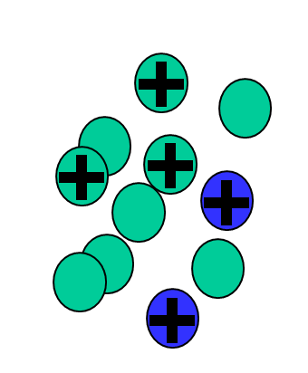
Sentinel Lymph Node Biopsy Neoadjuvant Therapy
Clinically node negative; before or after ?
+
+
+
+
+
+
+
+
+
After treatment
Identification rate?
+
False neg rate?
Notes:
In the end the argument really came down to how well does the procedure work after NAC…would we be able to identify the SLN and what would the false negative rate be if there was a variable response to tx in the nodal basin.
In the top picuture here the SLN would still accurately represent the status of the nodal basin, however in the bottom picture a neg SLN would be a false negative result.

Slide 15
SLN Biopsy and Neoadjuvant Therapy clinically node negative
 | SLN Identification rate | False-negative rate
BEFORE
McMasters et al (2000) | 86% and 90%¥ | 5.8 and11.8%¥
ALMANAC trial (2006) | 96.1% | 6.7%
NSABP B32 (2007) | 97.2% | 9.8%
Kim et al* (2006) | 96% (41-100%) | 7.3% (0-29%)
AFTER
NSABP B27 (2005) | 85% | 10.7%
Hunt et al (2009) | 97.4% | 5.9%
Xing et al**(2006) | 90% (72-100%) | 12% (0-33%)
Kelly et al***(2009) | 89.6% (95%CI 86.0-92.3) | 8.4 (95%CI 6.4-10.9)
¥ single agent vs dual agent
*Metanalysis 69 trials, 8059 pts; ** metaanalysis 21 trials, 1273 pts; ***metaanalysis 24 trials, 1799 pts
Notes:
There is now a large body of data demonstrating that in clinically node negative patients performing SLN biopsy before or after NAC results in the same identification rates – ranging from 85-97% and the same false negative rates, ranging from 5-12%.
These results are similar to B32 and other prospective multi-center trial in which SLN was performed before any systemic treatment.

Slide 16
SLN Biopsy After Neoadjuvant Therapy
MDACC 1994-2007, T1-3, cN0, n = 3746pts
 | SLN Identification rate | FNR | LRR*
SLN before chemo n = 3171 | 98.7% | 4.2% | 0.9%
SLN after chemo n = 575 | 97.4% (p = 0.02) | 5.9% (p = NS) | 1.2% (p = NS)
*median f/u 47 months
Notes:
In the largest single institution series, the MDA group reported on 575 pts having SLN after chemo as compared to 3171 pts with SLN before chemo – the SLN identification rates were both very good and very acceptable and the FNRs were similarly low – around 4-6%. And at a median followup of 47 months there were also no differences in LRR between the two arms.

Slide 17
Neoadjuvant Therapy Decreases Axillary Dissection
MDACC 1994-2007, T1-3, cN0, n = 3746pts
% Node Positive
 | SN first | Chemo first | P
T1 | 19.0 | 12.7 | 0.2
T2 | 36.5 | 20.5 | < .0001
T3 | 51.4 | 30.4 | 0.04
No difference in LRR (median f/u 47 mos)
Hunt KK, Ann Surg 2009;250:558
Notes:
Further This study demonstrated that NAC decreases the need for ALND most notably in pts presenting with larger T2 and T3 tumors where 15-20% fewer patients in the chemo first arm were node positive – thus were spared the morbidity of an ALND and again there was no difference in LRR at the time of this report.

Slide 18
How do you define cN0 axilla?
Do cN0 patients planning to undergo NAC need dedicated axillary imaging?

Slide 19
Abnormal imaging pre-NAC and post-NAC nodal status
402 stage I-III cN0 patients, NAC at MSKCC, 2008-2016
Pre-NAC, abnormal nodes on any imaging 208 (52%)
Ductal histology and larger tumor size
FNA performed in 128 (62%) and 75 (36%) proven N1
Post-NAC, 111 pts (28%) ypN+ at surgery
Non-ductal histology (OR 2.93), abn pre-NAC imaging (2.95), ER+ subtype (OR 3.94)
Any imaging | N | ypN+
Normal nodes | 194 | 39 (20%)
Abnormal nodes | 208 | 72 (35%)
65% of cN0 patients with abnormal nodes by imaging pre NAC
do not have positive nodes post NAC
Barrio et al. Ann Surg Oncol 2017
Notes:
MMG, US, MRI or PET

Slide 20
Axillary Imaging and post NAC nodal status cN0 patients
 | N = 402 | ypN+
Ultrasound
Normal | 31 | 7 (23%)
Abnormal | 131 | 52 (40%)
No US | 240 | 52 (22%)
MRI
Normal | 178 | 30 (17%)
Abnormal | 154 | 53 (34%)
No MRI | 70 | 28 (40%)
60% of patients with abnormal nodes on US and 65% of patients with
abnormal nodes on MRI do not have positive nodes post NAC
Barrio et al. Ann Surg Oncol 2017

Slide 21
In a cN0 patient where the decision to give preoperative therapy has already been made … does finding an abnormal node on imaging (+/- FNA) change outcome ?
No Data

Slide 22
Predictors of LRR after NAC pre- vs post-treatment nodal status
NSABP B-18 (AC)/B-27 (AC-T) MVA: Predictors of LRR combined dataset at 10yrs
Variable | HR | p
Age ≥ 50 yrs vs < 50yrs | 0.78 (0.63-0.98) | 0.03
Clin. Tumor Size > 5 cm vs ≤ 5cm | 1.51 (1.19-1.91) | <0.001
Clin. Node (+) vs. Clin. Node (-) | 1.61 (1.28-2.02) | <0.001
ypNode(-)/No breast pCR vs. ypNode(-)/breast pCR | 1.55 (1.01-2.39) | <0.0001
ypNode(+) vs. ypNode(-)/breast pCR | 2.71 (1.79-4.09)
Mamounas E et al JCO 2012
Notes:
So if we do SLN after chemotherapy can we still predict who is at increased risk for LRR and therefore would benefit from more aggressive local-regional therapy. The answer is yes, These are data from the combined analysis of B-18 and B27 demonstrating that it is a combination of both pretx clinical factors, age, tumor size and clinical nodal status as well as response to therapy both in the nodes and in the breast that predict for LRR.

Slide 23
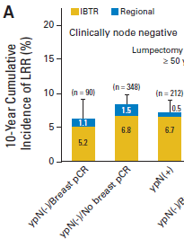
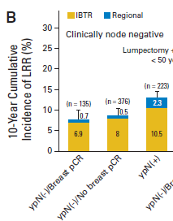
LRF by Path Nodal Status and pCR
B-18/B-27 : cN0 Lumpectomy pts
>= 50yrs
< 50yrs
Low rates of regional recurrence all patients
irrespective of nodal and breast pCR status
Mamounas E JCO 2012
Notes:
If we look at only those clinically node negative pts undergoing lumpectomy after NAC in B18/27, we see low rates of regional recurrence for all patients irrespective of nodal and breast pCR status

Slide 24
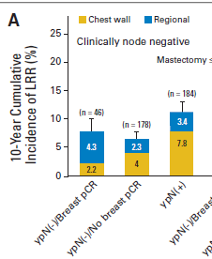
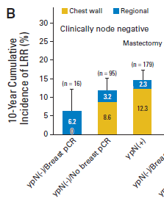
LRF by Path Nodal Status and pCR
B-18/B-27 : cN0 Mastectomy pts
No
PMRT
Allowed
T< 5cm
T > 5cm
Low rates regional recurrence all groups;
increased CW recurrence node + after tx
Mamounas E JCO 2012
Notes:
And in clinically node negative pts undergoing mastectomy, we again see low rates of regional recurrence (2-6%) in all groups but we do see increased rates of CW recurrence (the yellow portion of the bars) in pts with residual nodal disease

Slide 25
Regional Recurrence Neoadjuvant Therapy
B18/B27 – cN0 assessed by PE not US – very low rates of regional recurrence,
no PMRT, pre-dated routine taxanes and anti-her 2 therapy
B18/B27 | RR at 10 yrs
cN0 lumpectomy | >= 50 yrs | < 50 yrs
 | 0.5-1.5% | 0.5-2.3%
cN0 mastectomy | T < 5cm | T > 5cm
 | 2.3-4.3% | 2.3-6.2%
Axillary US cN0 patients? T1,T2 tumors – NO
T3 consider
Notes:
A question I am often asked is Do all clinically node negative patients need a pre-treatment axillary US ?
Based on these data that we just reviewed where clinically node negative was defined by PE only and these trials were performed without the benefits of targeted therapies we are using today - My answer is no for patients with T1,T2 disease undergoing BCT or Mastectomy but I do consider in pts with T3 tumors undergoing mastectomy

Slide 26
Sentinel Lymph Node Biopsy After Neoadjuvant Therapy A Practical Approach
Clinically node negative
SLN biopsy after NAC
Intraoperative Frozen Section of SLN
cALND for failed mapping
cALND for any positive LN including micrometastatic disease
Radiation tx decisions made with combination of pre-tx factors and final path status (nodes, breast)

Slide 27
Sentinel Lymph Node Biopsy Neoadjuvant Therapy
Clinically node positive pt that converts to cN0 ?
+
+
+
+
+
+
+
+
+
Identification rate?
+
False neg rate?
Notes:
What about the cN+ patient that converts to cN0 – as you know we have recently gone through the same exercise to determine the ID rate and FNR for this group…

Slide 28
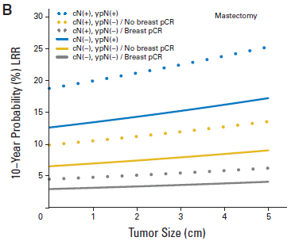
Pre- vs post-treatment nodal status impact on LRR
NSABP B-18 (AC)/B-27 (AC-T)
cN+ ypN+ LLR >25%
cN+ ypN- no breast pCR
cN+ ypN- breast pCR
Mamounas E et al JCO 2012
Notes:
I would argue that in this population it is also of utmost Importance to identify residual disease as these patients have a substantial risk of CW recurrence after TM without PMRT – as shown here again in data from the combined analysis of B-18 and B27

Slide 29
ACOSOG Z1071
Eligible
T0-T4, N1-2, M0
Biopsy Proven
Nodal disease
n = 663 cN1
SN ID rate 95%
649 SN ALND
≥ 2 SN identified
n = 525, 79%
Failed to meet
primary endpoint
FNR ≤ 10%
FNR
12.6% (9.9, 16.1)
Boughey JC, JAMA 2013
Notes:
One of the first trials to examine the question of whether or not we could successfully perform SLN bx in this setting was the ACOSOG 1071 trial – presented here at this meeting in 2013. This trial enrolled 663 pts with cN1 disease, they all underwent SLN bx for an ID rate of 95%; and these pts then went onto ALND. The primary analysis was predicated on the removal of at least 2 SLN which was achieved in 525 pts or 79% and the overall FNR was 12.6%, unfortunately this exceeded the anticipated FNR of <=10% and therefore the study did not meet its primary endpoint.
T0-T4, N1-2 M0
Histologically proven N+
Treatment: NAC SN ALND
≥ 2 SN identified
Endpoint: FNR ≤ 10%

Slide 30
ACOSOG Z1071 – cN1 patients
How do we translate these findings in clinical practice ???
FNR by Number of SN
# SN Removed | 1 | 2 | ≥ 3
% of Cases | 12% | 24% | 57%
False Negative Rate | 32% | 21.1% | 9.1% | p=.007
Boughey JC, JAMA 2013
Notes:
However when the investigators examined the FNR by the number of SLN removed- the FNR did meet the primary endpoint of <10% in those patients with >=3 SLN removed and this represented just under 60% of study population.
The relationship between the number of SLNs removed and the FNR of the procedure is not a new finding as this was clearly documented in the early prospective trials of SLNB in patients undergoing upfront surgery (46, 140, 143, 152). The difference However, is that in patients who undergo upfront surgery, and in clinically node negative patients who receive NACT, the FNR is acceptable when fewer than 3 nodes are removed (47, 136-144); thus until now there has not been a discussion of a minimum number of nodes that must be identified and removed.

Slide 31
SLN Biopsy After Neoadjuvant Therapy cN1 convert cN0
 | ACOSOG Z1071 | SENTINA | SN FNAC
N | 649 | 592(cN+)* | 153
Mapping | Dual tracer recommended (79%) | Technetium required | Technetium required, IHC
Pre-op biopsy? | Yes | Not required (biopsy =25%) | Yes
Nodal pCR | 41% | 52% ypN0 (?) | 35%
IR | 92.7% | 80.1% | 87.6%
FNR (Overall) | 12.6% | 14.2% | 8.4%
1 SLN | 31.5% | 24.3% | 18.2%
2 SLN | 21.1% | 18.5% | 4.9%
≥3SLN | 9.1% | 7.3%
*1737 patients enrolled in 4 arm multicenter trial. 592 ARM C were cN+ to cN0
Notes:
There are now several other trials showing the same phenomenon in this population – Arm C of the SENTINA trial – enrolled 592 cN+ pts that converted to N0 after treatment with an overall FNR of 14% and the SN FNAC trial enrolled 153 pts and included IHC only disease in the definition of a positive SLN with an overall FNR of 8.4%. All studies documented that the FNR decreased wiith and increasing number of nodes removed

Slide 32
SLN After Neoadjuvant Therapy cN+ convert to cN0
Consistent unacceptable FNR unless ≥ 3 SN removed
Residual disease potentially resistant to treatment
No data on LRR in this setting
Do know importance of path node status in predicting LRR … implications for RT
Notes:
The majority of the data suggests that the FNR unacceptable unless 3 or more nodes removed – minimizing the FNR important as this disease potentially resistant to treatment and at this point we don’t have any data on LRR in this setting. As I eluded to earlier – we do know the importance of path node status in predicting LRR

Slide 33
Pre- vs post-treatment nodal status impact on LRR
No PMRT
cN+ ypN+ LLR >25%
cN+ ypN- no breast pCR
cN- ypN- no breast pCR
cN+ ypN- breast pCR
cN- ypN- breast pCR
Mamounas E et al JCO 2012
NSABP B-18 (AC)/B-27 (AC-T)
Notes:
Going back to the combined analysis of B-18 and B-27 – pts that start out cN+ and convert to pathologically node negative w/ breast pCR have rates of LRR that are under 10% following TM without PMRT - even with larger tumor sizes and these rates are not that different from patients that start our cN negative.
In contrast, those patients that remain node positive have substantial rates of LRR even with small tumors and would likely benefit from more aggressive local regional therapy

Slide 34
SLN biopsy after NAC cN1 convert to cN0 suggestions to minimize the FNR
Dual agent mapping
Normal exam after chemotherapy
Remove ≥ 3 SLN
Include IHC detected disease as node positive
Leave a clip at time of biopsy and localize for SLN
ACOSOG Z1071: 57% SENTINA: 34%
Notes:
The consistency of the data from the 3 trials discussed above combined with an increasing desire to safely avoid ALND in women who achieve a nodal pCR have led many groups to consider how to implement these findings in clinical practice, with a focus on minimizing the FNR of the procedure. One approach has simply been to mandate dual agent mapping, document a normal exam after chemo and require removal of at least 3 SLN
Some have questioned how practical this is – how many pts have 3 SLN ?, well In ACOSOG Z1071, 57% of 641 clinically N1 patients who converted to clinically node-negative disease had 3 or more SLNs removed and in Arm C of the SENTINA trial this number was only 34% (150, 151); suggesting that a substantial numbers of patients will not have three or more SLNs identified after NACT in this setting.

Slide 35
SLN biopsy after NAC, cN1
Prospective study MSKCC, 2013-2015
155 pts stage II-III, cN1, eligible for downstaging to SLNB
132 (85%) converted cN0, 128 attempted SLN
 | N=128
SLN identified | 125* (98%)
≥3 SLN removed | 110** (86%)
Median # SLN removed | 4.0 (1-14)
62 (56%)
≥3 SLN neg FS
No ALND
*3 failed to map despite use of dual tracer, 2/3 ypN+
**15pts < 3 SLN, 12/15 ALND, 7/12 (58%) ypN+
Mamtani et al. Ann Surg Oncol 2016
Notes:
In a recent prospective study of this approach reported by MSKCC; 155 pts with cN1 disease who were considered to be eligible for downstaging to SLNbx were treated with NAC; 132 converted to cN0 status and SLN was attempted in 128 pts. Using dual tracer technique the SLN was identified in 125 (98%) of patients and 110 or 86% had >=3 SLN removed. Median number of SLN was 4. All SLN were sent for FS and in this group – 62 (56%) had 3 or more neg SLN and were spared an ALND… although we await data on LRR failure in this setting – this study demonstrates that with dual tracer technique 3 or more SLN can be identified in the majority of pts

Slide 36
SLN biopsy after NAC - cN1 convert to cN0 suggestions to minimize the FNR
Dual agent mapping
Normal exam after chemotherapy
Remove ≥ 3 SN
Include IHC detected disease as node positive
Leave a clip at time of biopsy and localize for SLN
Notes:
What about IHC disease ? Should this be included as node positive

Slide 37
SLN Biopsy After Neoadjuvant Therapy cN1 convert cN0
 | ACOSOG Z1071 | SENTINA | SN FNAC
N | 649 | 592(cN+)* | 153
Mapping | Dual tracer recommended (79%) | Technetium required | Technetium required, IHC
Pre-op biopsy? | Yes | Not required (biopsy =25%) | Yes
Nodal pCR | 41% | 52% ypN0 (?) | 35%
IR | 92.7% | 80.1% | 87.6%
FNR (Overall) | 12.6% | 14.2% | 8.4%
1 SLN | 31.5% | 24.3% | 18.2%
2 SLN | 21.1% | 18.5% | 4.9%
≥3SLN | 9.1% | 7.3%
*1737 patients enrolled in 4 arm multicenter trial. 592 ARM C were cN+ to cN0

Slide 38
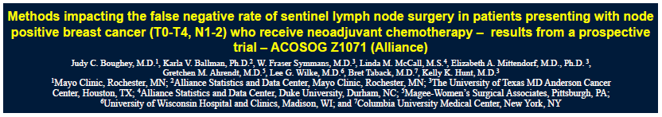
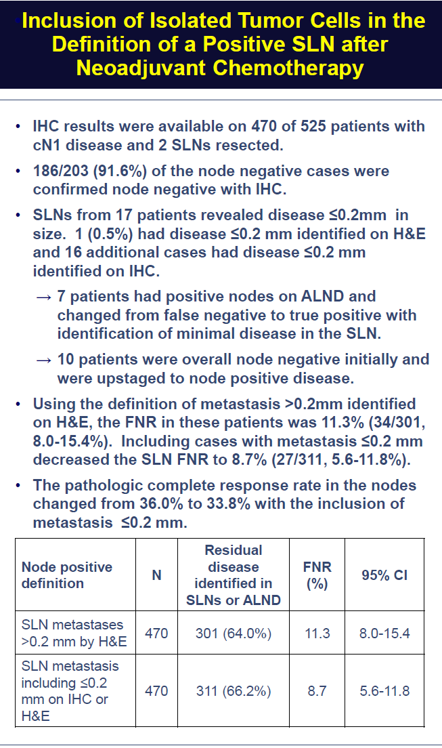
Inclusion of micromets (<0.2mm) in the definition of residual nodal dz after neoadj tx reduces the pCR rate and improves the accuracy of SLN
2014 SABC, Boughey et al.
Notes:
Data on IHC detected disease was also available for a subset of 470 pts patients from Z1071 – Boughey et al reported that if mets < 0.2mm on H&E or IHC were included in the definition of node positive – additional residual disease was identified in just over 2% of patients and the FNR fell to 8.7%

Slide 39
Evaluation of SLN after NAC
Significance of residual ITC’s or disease <0.2mm (ypN0i+) after NAC unclear
2012 WHO classification: small nodal mets and ITCs are evidence of an incomplete response
7th (and 8th) edition AJCC TNM Staging Manual
ypN0i+ or ypN1mi residual nodal disease ALND remains standard of care
Notes:
I think this is important to consider as the significance of residual ITCs or disease <0.2mm after NAC remains unclear
In the 2012 WHO classification – small nodal mets and ITCs are considered evidence of an incomplete response and according to the 7th edition of the AJCC TNM staging manual – the finding of ITC or micromets after NAC – warrants ALND.
isolated tumor cells (ypN0i+, <0.2mm), micrometastatic disease (ypN1mi, 0.2mm-2.0mm), and macrometastatic disease (ypN+, >2.0mm) in SLN after NACT is another factor that remains In a retrospective pathology study of 80 patients with biopsy proven N1 disease who received NACT followed by ALND, patients with a nodal pCR had improved DFS (p=0.007) and OS (p=0.004) when compared to those with micrometastatic disease; yet there was no difference in DFS or OS between those with residual micrometastatic vs macrometastatic disease (157). According to the 7th Edition of the American Joint Committee on Cancer (AJCC) staging system (158), patients treated with NACT who are ypN0i+ or ypN1mi at SLNB are considered to have residual nodal disease, and ALND remains the standard of care. In the SN FNAC study (149), SLN metastases of any size were considered positive, and in contrast to the body of literature in patients undergoing upfront surgery (51, 56, 57), there was no correlation between the size of the SLN metastases and the rate of positive non-SLNs.

Slide 40
SLN biopsy after NAC - cN1 convert to cN0 suggestions to minimize the FNR
Dual agent mapping
Normal exam after chemotherapy
Remove ≥ 3 SN
Include IHC detected disease as node positive
Leave a clip at time of biopsy and localize for SLN
Notes:
What about leaving a clip ….

Slide 41
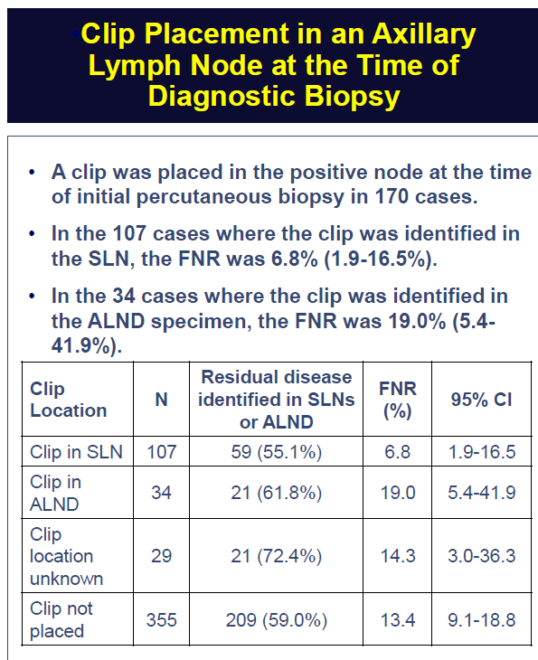
Clip placed
170 pts
20% pts
clip not
in SLN
Placement of a clip + identification of the clip during SLN
and removal at least 2 SLN reduces FNR
2014 SABC, Boughey et al.
Notes:
This was first reported for a subset of 170 patients in the ACOSOG Z1071 trial, where among the 107 patients in whom the clipped node was retrieved as a SLN, the FNR was 6.8% (153).
Importantly the clipped node was not retreived as a SLN in ~20% of patients

Slide 42
MDACC Experience Clipping the node for SLN after NAC
Clipped node +/- SLN to reflect the status of the nodal basin in all-comers undergoing NAC
 | N | Node + | pCR (%) | FNR (%)
Clipped node | 191 | 120 | 37% | 4.2% (95%CI 1.4-9.5)
SLN | 118 | 74 | 37% | 10.1% (95%CI 4.2-19.8)
SLN + clipped node | 118 | 74 | 37% | 1.4% (95%CI 0.03-7.3)
Also noted clipped node was not a SLN in ~ 20% pts
“Targeted Axillary Dissection”
Caudle AS et al JCO 2016;34(10):1072-8
Notes:
The MDACC group has since expanded upon this practice and reported a FNR of 4.2% when the clipped node was analyzed independently in a cohort of 120 patients who remained pathologically node positive after NACT. When the clipped node and the SLN were analyzed together (n=74), the FNR decreased to 1.4% (154). However, similar to the ACOSOG Z1071 experience, the clipped node was in the axillary contents but not identified as a SLN in approximately 20% of patients (153). As a result, they implemented a practice of localizing the clipped nodes preoperatively with iodine-125 seeds and have termed this procedure TAD (Targeted Axillary Dissection) (154). A similar technique called the MARI procedure (marking the axillary node with radioactive seed) has been reported in the Netherlands (155) and others are investigating the utility of tattooing the positive node with a sterile black carbon suspension (156).

Slide 43
Sentinel Lymph Node Biopsy After Neoadjuvant Therapy
Clinically node positive (N1) converts to node negative
SLN biopsy after NAC w/ dual mapping agents
If node not clipped, remove at least 3 SLN,
If node clipped, clipped node + SLNs
Intraoperative frozen section of all nodes removed
cALND for
failed mapping
fewer than 3 SLN (or failure to retrieve clipped node)
any positive LN including micrometastatic disease/ITCs (unless on trial)
Notes:
The careful incorporation of SLNB into the clinical management of patients who present with biopsy proven nodal disease and have a significant response to NACT, defined at the present time as conversion to clinically node negative status, represents a significant shift in clinical practice and an opportunity to further decrease surgical morbidity for our patients. For patients who remain pathologically SLN node positive after NACT, the question of whether completion ALND can be omitted in favor of axillary radiotherapy, which is associated with lower rates of lymphemeda (69), is being addressed in the ongoing phase III A011202 trial, conducted by the Alliance for Clinical Trials in Oncology (Figure 1)(160). For patients who are pathologically node negative, either by SLNB or ALND after NACT, the NSABP B‑51/ Radiation Therapy Oncology Group (RTOG) 1304 (NRG 9353) is conducting a phase III randomized trial of more versus less radiotherapy (Figure 2)(161). If omitting regional nodal radiation and/or PMRT in patients who achieve a nodal pCR in this setting does not impact risk of LRR, NACT could become the new standard to facilitate a tailored approach to locoregional therapy in patients with operable node-positive breast cancer.

Slide 44
Post NAC Trials of Axillary Management
ALLIANCE A11202 Schema
NSABP B-51/RTOG 1304 (NRG 9353) Schema
Clinical T1-3 N1 M0 BC
Clinical T1-3 N1 M0 BC
Axillary nodal involvement (FNA or core needle biopsy)
Neoadjuvant Chemotherapy
Neoadjuvant chemo (+ Anti-HER-2 therapy for HER-2 neu ⊕ pts)
BCT or Mastectomy Sentinel Lymph Node Surgery
Definitive surgery with histologic documentation of negative axillary nodes (by axillary dissection or by SLNB ± axillary dissection
SLN Negative
SLN Positive
Stratification Type of surgery (mastectomy vs lumpectomy) ER status (+ vs -), HER-2 status (+ vs -) pCR in breast (yes vs no)
Randomization
ALND ⊕
Breast/chest wall and nodal XRT (no Axillary RT)
No further axillary surgery. Breast/chest wall and nodal XRT (incl. Axilla)
Randomization
No Regional Nodal XRT with breast XRT if BCS & No chest wall XRT if mastectomy
Regional Nodal XRT with breast XRT if BCS and chest wall XRT if mastectomy
Notes:
These are the two large coop group trials ongoing in the US – on your left is the ALLIANCE A11202 trial for patients with T1-3N1 disease that covert to N0 and undergo SLN biopsy – if found to be node positive they are randomized to
The sister trial through the NSABP / RTOG – the same group of patients but now node negative by FS or ALND – randomized to
These two trials are asking differnet questions…

Slide 45
Post NAC Trials of Axillary Management
ALLIANCE A11202 Schema
NSABP B-51/RTOG 1304 (NRG 9353) Schema
Clinical T1-3 N1 M0 BC
Clinical T1-3 N1 M0 BC
Axillary nodal involvement (FNA or core needle biopsy)
Neoadjuvant Chemotherapy
Neoadjuvant chemo (+ Anti-HER-2 therapy for HER-2 neu ⊕ pts)
BCT or Mastectomy Sentinel Lymph Node Surgery
Definitive surgery with histologic documentation of negative axillary nodes (by axillary dissection or by SLNB ± axillary dissection
SLN Negative
SLN Positive
Randomization
Randomization
Can response to NAC be used to select patients who do not need PMRT or extended nodal RT?
Can axillary RT
replace ALND ?
Notes:
These two trials are asking differnet questions…

