Slide 2
Neoadjuvant Therapy for HER2+ Disease
Eric P. Winer, MD
Dana-Farber Cancer Institute
Harvard Medical School
Eric_Winer@dfci.harvard.edu

Slide 3
Why Administer Preoperative Therapy for Operable Breast Cancer?
Downstage tumor to allow for greater chance of conservative surgery (particularly advantageous in those who clearly need radiation)
Reduce the extent of axillary surgery (SNB in lieu of ALND)
In trials use response in breast as a surrogate for DFS/OS in adjuvant trials
Improve predictions of prognosis for individual patient
?? GUIDE SEQUENT SYSTEMIC THERAPY DECISIONS ??

Slide 4
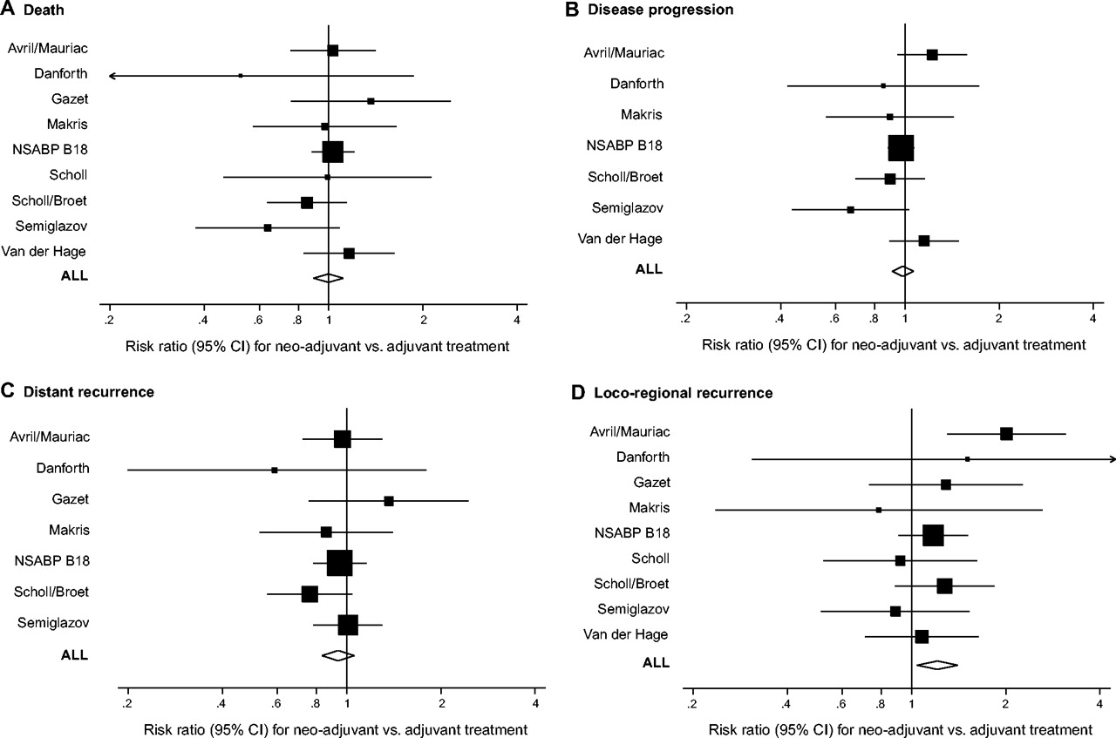
Meta-Analysis of Preoperative vs
Postoperative Chemotherapy
Death
Disease Progression
Distant Recurrence
analysis for primary outcomes with adjuvant therapy for breast cancer.
But most studies of modest size and
entire cohort only included
3946 patients
Ability to look for differences in
subtypes limited
Mauri D et al. JNCI J Natl Cancer Inst 2005;97:188-194
Journal of the National Cancer Institute, Vol. 97, No. 3, © Oxford University Press 2005, all rights reserved.
Notes:
Meta-analysis for primary outcomes with neoadjuvant therapy compared with adjuvant therapy for breast cancer. In each panel, each study [Van der Hage et al. (8), Avril et al./Mauriac et al. (9,10), Semiglazov et al. (11), Scholl et al. (12), Scholl et al. (13), Broet et al. (14), Makris et al. (15), NSABP B-18 (16,17), Gazet et al. (18), Danforth et al. (19)] is shown by the point estimate of the risk ratio (square proportional to the weight of each study) and 95% confidence interval (CI) for the risk ratio (extending lines); the summary risk ratio (ALL) and 95% confidence intervals by fixed effects calculations are also shown by diamonds. For all panels, values greater than 1 indicate that neoadjuvant treatment has a worse outcome compared with adjuvant treatment. (A) Death. (B) Disease progression. (C) Distant disease recurrence. (D) Loco-regional disease recurrence. Arrow = 95% confidence interval extends beyond the depicted range.

Slide 5
Preoperative trastuzumab & paclitaxel DF/PCC Trial in Stage II/III Disease (Burstein et al, JCO 2003)
LVEF testing
Treatment Plan
Paclitaxel 175 mg/m² q 21 d x 4
Trastuzumab weekly x 12
baseline
Assess
Clinical
Response
p 12 weeks
Trast & Pacl
Definitive Breast Surgery
Assess
Pathological
Response
Between 42 and 63 days from
last trastuzumab dose
AC (60/600 mg/m²)
q 21 d x 4 cycles
N = 40
22 stage II
18 stage II
26 with ER+ disease
p 2 cycles AC
p 4 cycles AC

Slide 6
Preoperative Trastuzumab & Paclitaxel:
Tumor Response Rates
*1 pt not assessable; off study for paclitaxel hypersensitivity reaction

Slide 7
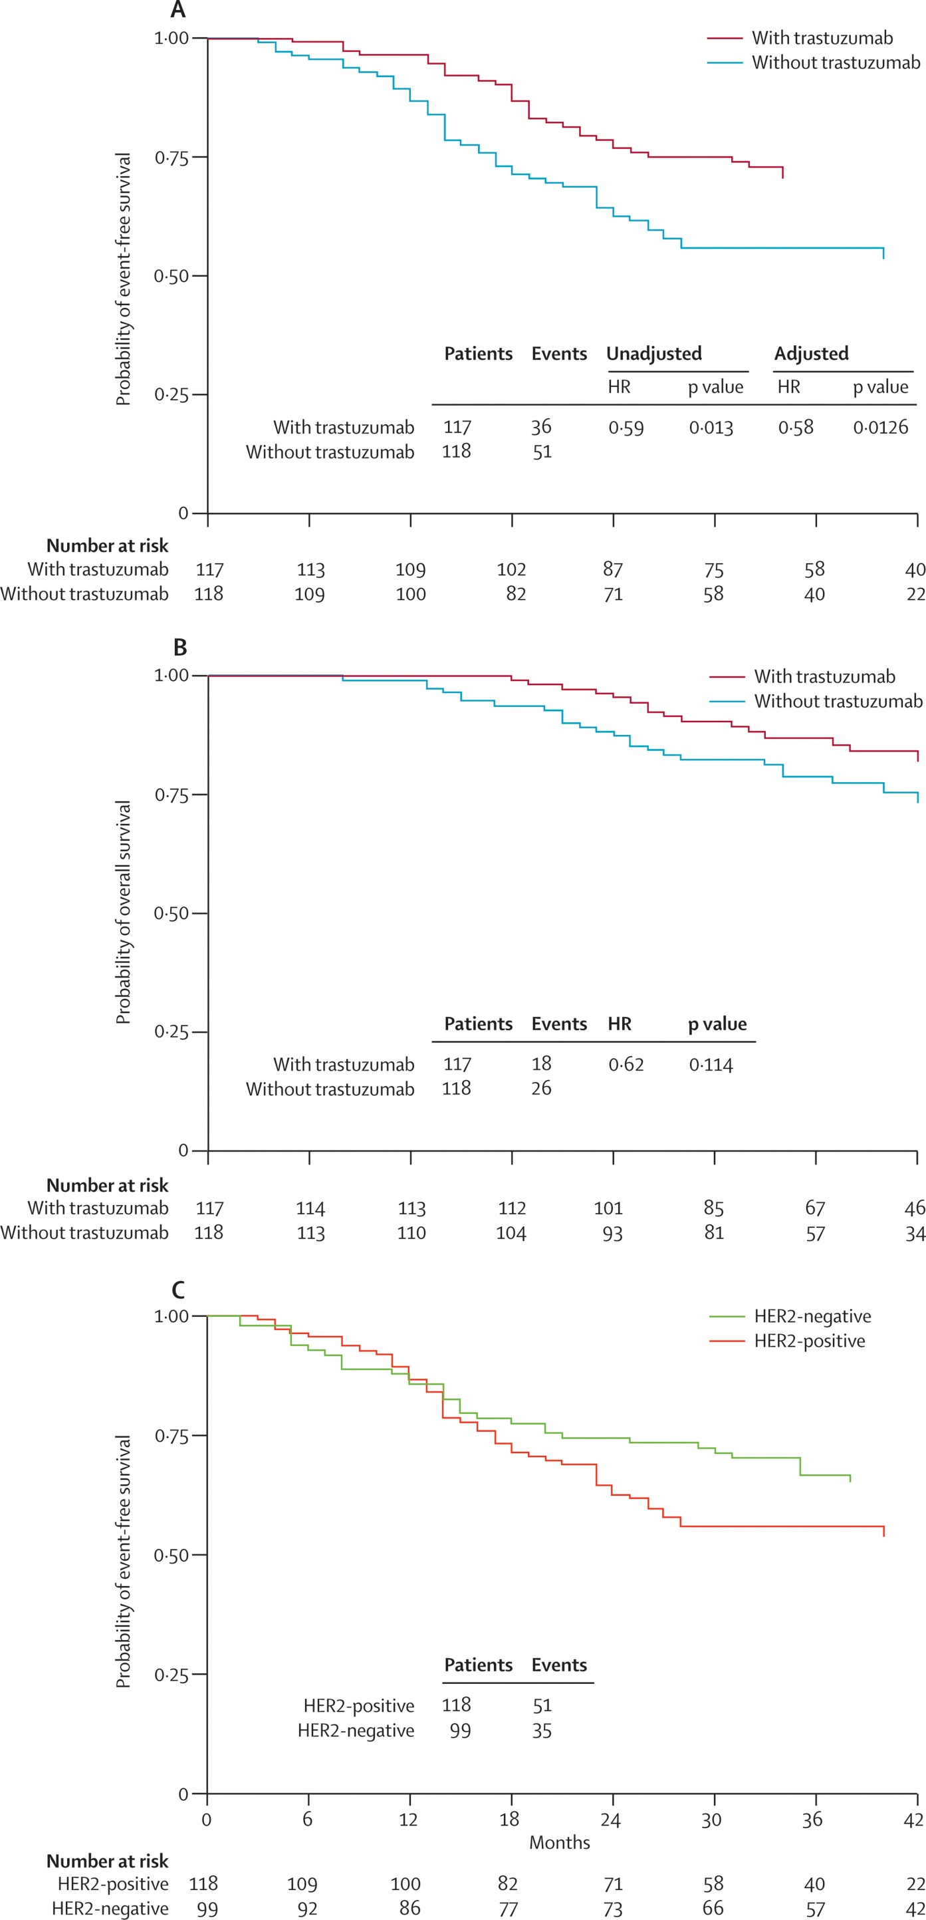
NOAH Trial: Preoperative Chemo +/- Trastuzumab for LABC
Path CR Breast/Nodes
Chemo + trast 38%
Chemo only 19%
Gianni L, et al; Lancet 2010

Slide 8
2nd Generation Neoadjuvant Trials: Tests of Dual Targeting and Identification of
Molecular Predictors

Slide 9
pCR Rates With Neoadjuvant Lapatinib Containing Regimens
Pac Pac→FEC FEC → Pac EC → Doc
Courtesy of HJ Burstein

Slide 10
In spite of higher path CR rate with most lapatinib containing regimens, the ALTTO trial failed to demonstrate a significant improvement in DFS/OS for lapatinib
BUT….there are still biologic insights that can be gained from these studies

Slide 11
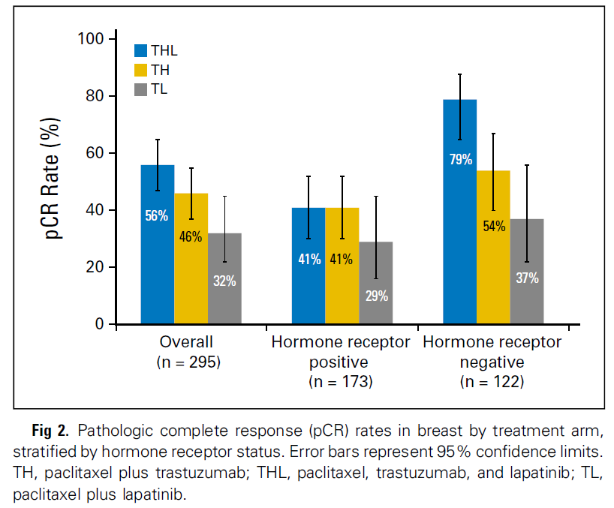
CALGB 40601: Paclitaxel + Trastuzumab, Lapatinib, or Both x 16 weeks
Path CR by Treatment Arm and HR Status
Carey et al, JCO 2015

Slide 12
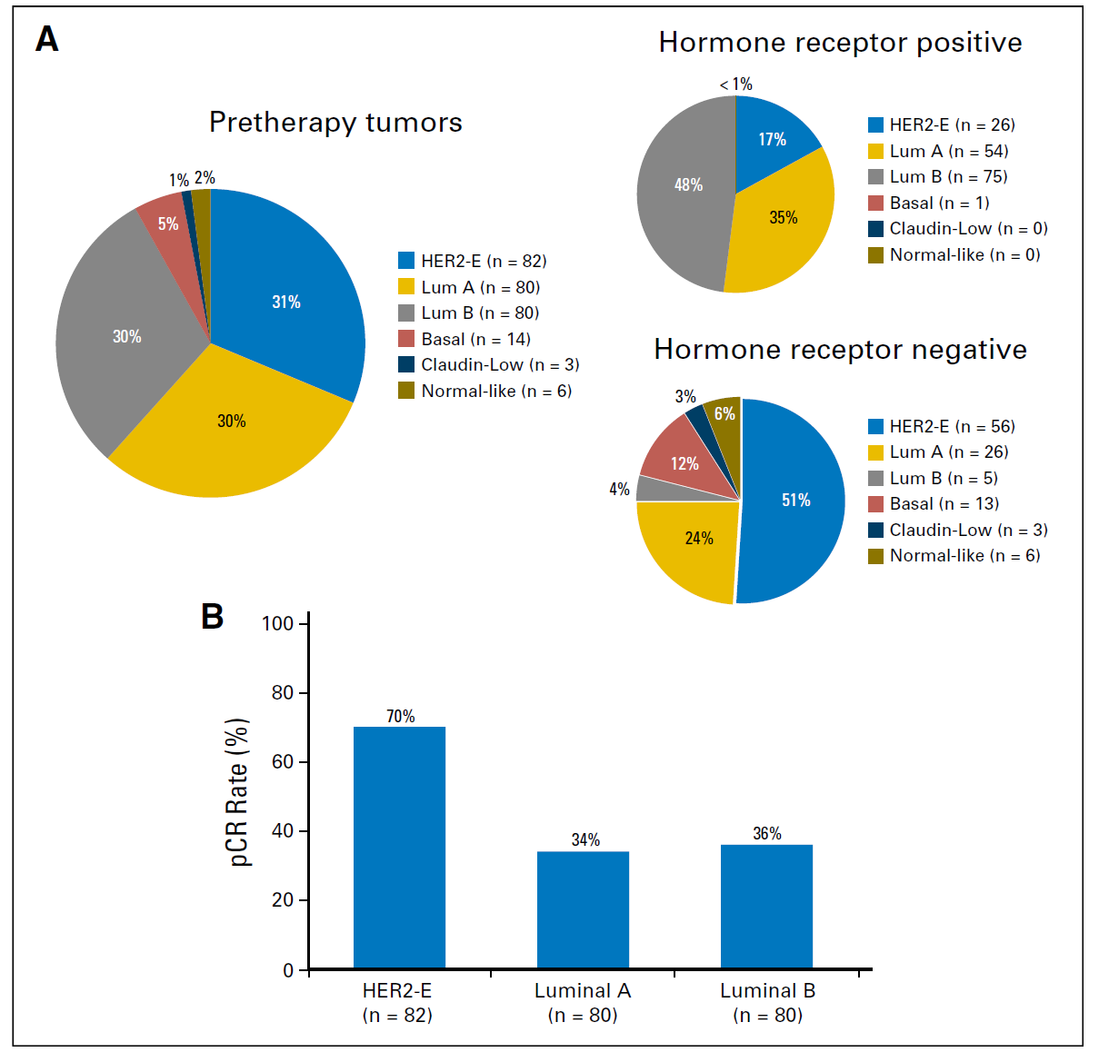
Distribution of Tumors by Intrinsic Subtype and Path CR by Subtype

Slide 13
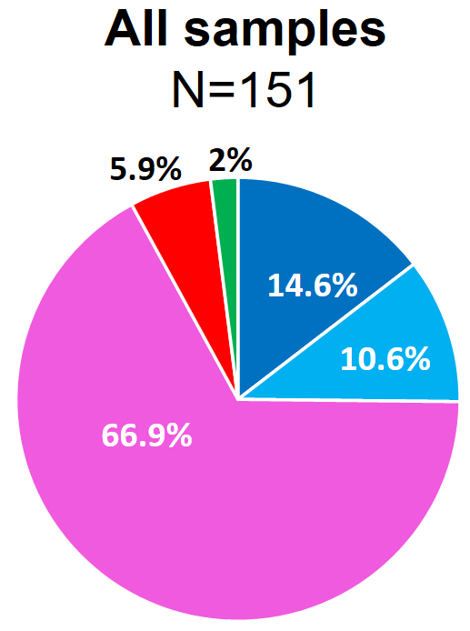

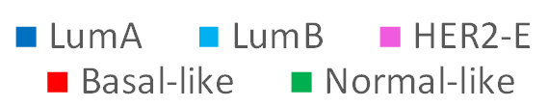
Intrinsic Subtype at Baseline vs. pCR in the Breast
Baseline samples (N=151)
pCR
∆=30.6%
∆=24.7%
pCR rate
40.6%
34.7%
10.0%
10.0%
Prat et al. SABCS 2016; Lancet Oncol 2017

Slide 14
pCR Associated with Immune Cell Signatures in CALGB 40601
Activity of 5 immune signatures tested:
B-cell
T-cell
CD8 T-cell
IgG
“HER2+ immune cell”
All significantly associated with ⬆ pCR
P<0.001
Iglesia et al, CCR in press; Fan et al, BMC Med Genomics 2011
Carey et al, ASCO 2014
Notes:
NEED CITATIONS FOR EACH OF THESE SIGNATURES. SHOULD WE DO TIL ANALYSIS IN THESE TISSUES?
Talk with Luca about these data
Points to make: In NeoSphere, PDL1 and CTLA4 were associated with pCR. Similarly we found that a variety of immune signatures were associated with pCR. Investigators from BIG have found that benefit of trastuzumab appears heavily influenced by the presence of substantial tumor-infiltrating lymphocytes. We examined a variety of signatures. In all cases, an activated signature was associated with higher pCR rates regardless of dual or single HER2 therapy.

Slide 15
NeoSphere: Study Design
TH (n=107)
Docetaxel + Herceptin
S
U
R
G
E
R
Y
FEC q3w x 3
Herceptin q3w cycles 5–17
THP (n=107)
Docetaxel + Herceptin +
Pertuzumab
FEC q3w x 3
Herceptin q3w cycles 5–17
Patients with operable or
locally advanced /inflammatory*
HER2-positive BC
Chemo-naïve &
primary tumours
>2cm (N=417)
HP (n=107)
Herceptin + Pertuzumab
Docetaxel q3w x 4→FEC q3w x 3
Herceptin q3w cycles 5–17
TP (n=96)
Docetaxel + Pertuzumab
FEC q3w x 3
Herceptin q3w cycles 5–21
Study dosing: q3w x 4
BC, breast cancer; FEC, 5-fluorouracil, epirubicin and cyclophosphamide
*Locally advanced=T2–3, N2–3, M0 or T4a–c, any N, M0; operable=T2–3, N0–1, M0; inflammatory = T4d, any N, M0
Gianni et al Lancet 2012
Notes:
15

Slide 16
NeoSphere pCR Rates
50
p = 0.0141
45.8%
40
30
pCR, % ± 95% CI
29.0%
20
24.0%
16.8%
10
0
TH
THP
HP
TP
Treatment
Gianni L, et al. Lancet Oncology 2011
Notes:
16

Slide 17
Pathologic CR Rates In NeoSphere
 | Trast/ Docetaxel | Pertuz/ Docetaxel | Trast/ Pertuz/ Docetaxel | Trast/ Pertuz
ITT (Overall) | 29% | 24% | 46% | 17%
ER- | 37% | 30% | 63% | 27%
ER+ | 20% | 17% | 26% | 6%
Gianni et al, Lancet 2011

Slide 18
Pathologic Response in TRYPHAENA
Regimen | Path CR (ypT0/is) N=225
FEC/HP x 3➔ Doc/HP x 3 | 62%
FEC x 3➔ Doc/HP x 3 | 57%
TCH/P x 6 | 66%
Schneeweiss et al, Ann Oncology 2013

Slide 19
The Role of Pertuzumab in Standard HER2+ Neoadjuvant Therapy
FDA approved pertuzumab in neoadjuvant setting in combination with docetaxel and trastuzumab followed by FEC or with TCH
Approval based on promising NEOSPERE data, metastatic survival advantage, and completion of adjuvant trial
The limited benefit of pertuzumab in the adjuvant setting confirms some biologic insights from neoadjuvant setting and raises questions about routine use of pertuzumab in some patients
This approach is best reserved for patients at particularly high of recurrence (e.g. ER-, stage IIB and III disease)

Slide 20
3rd Generation HER2 Neoadjuvant Trials: A Step Beyond Simple Dual Targeting

Slide 21
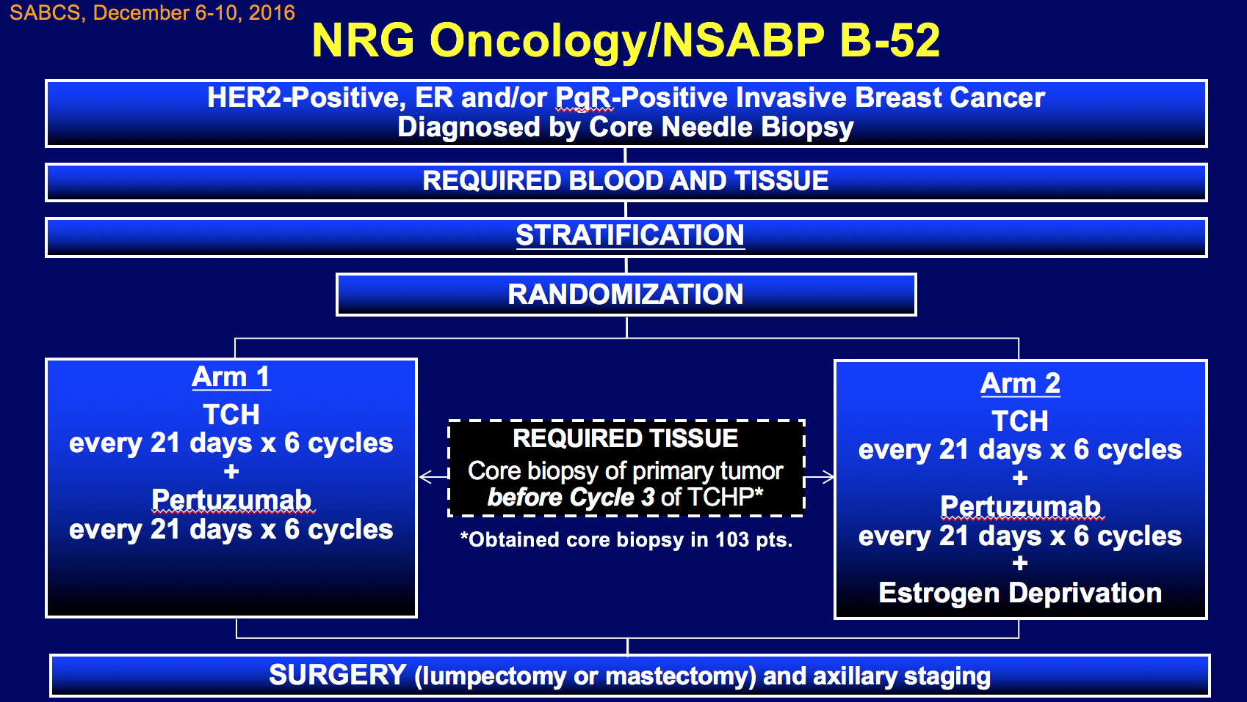
NSABP B-52 Schema: HER2-based preop therapy +/- estrogen deprivation
Rimawi et al, SABCS 2016

Slide 22
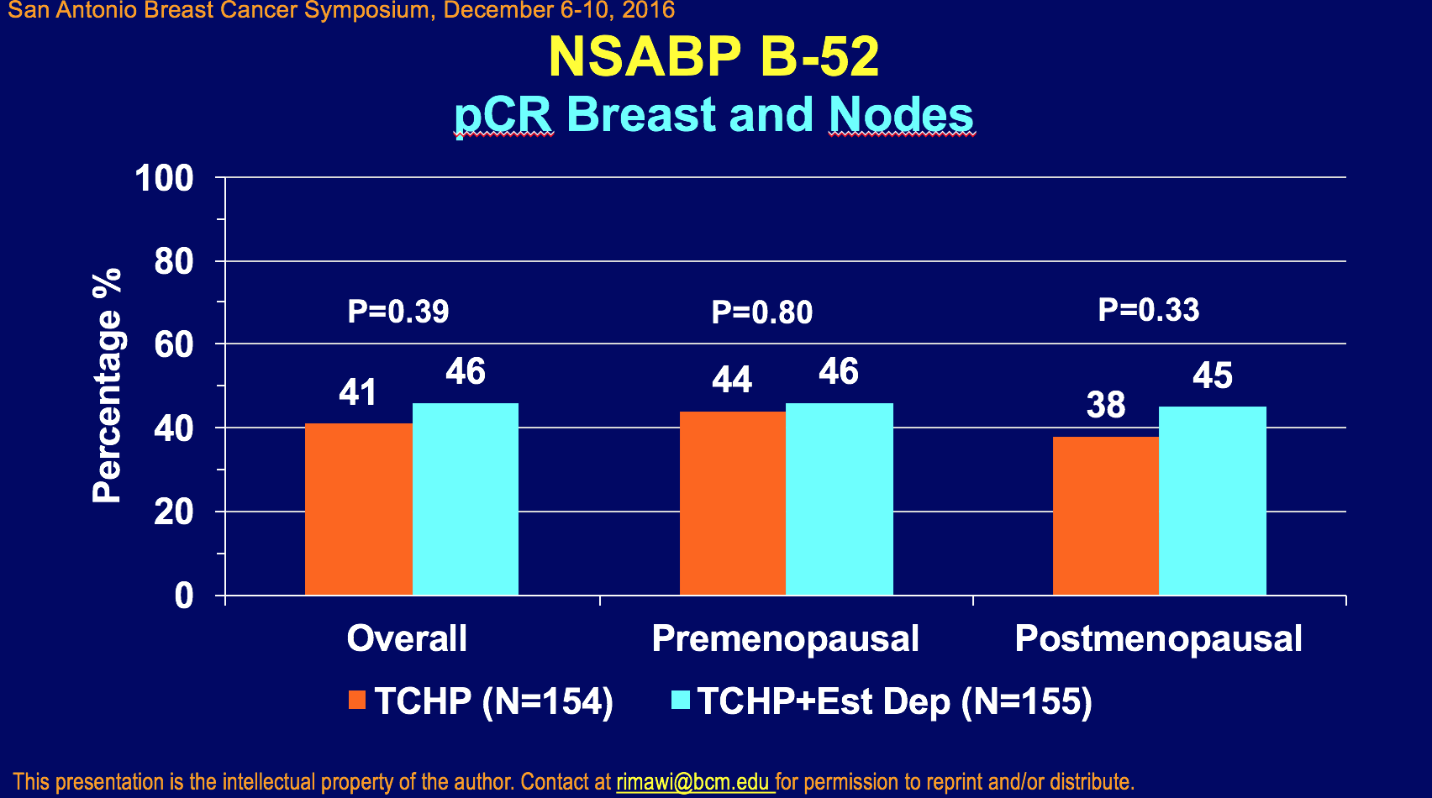

Slide 23
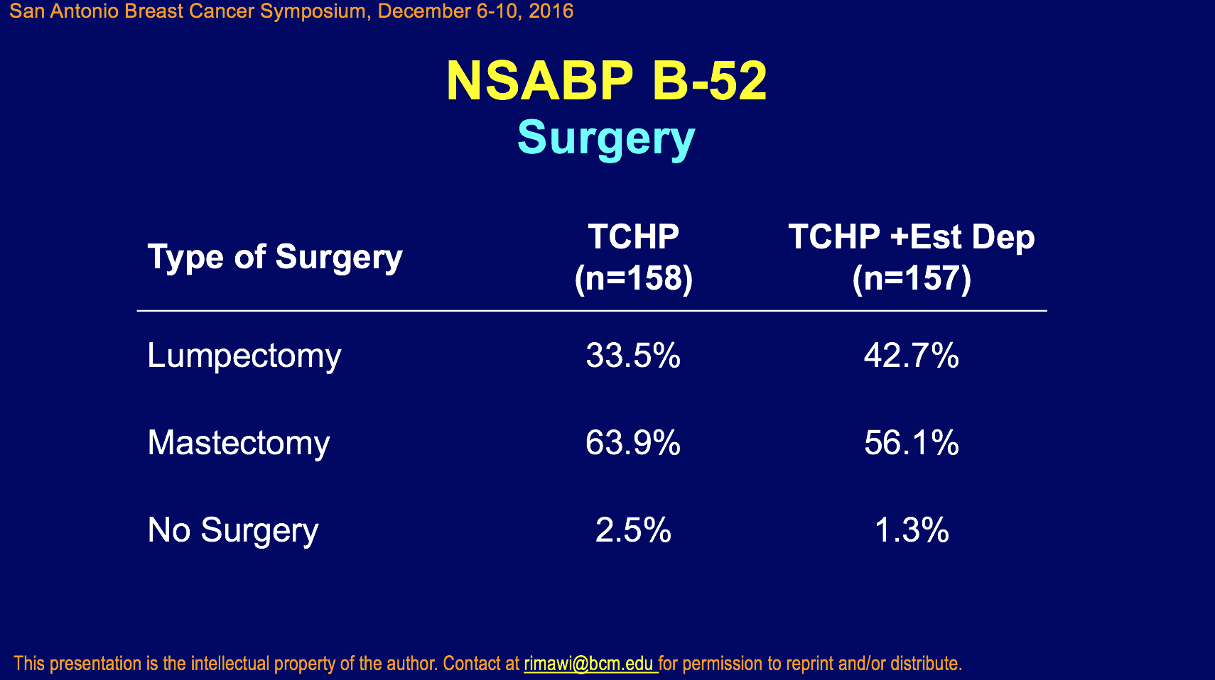

Slide 24
KRISTINE Study Design
Docetaxel
Centrally confirmed HER2-positive, operable, locally advanced or inflammatory
breast cancer
Tumor >2cm
N=432
R
A
N
D
O
M
I
Z
A
T
I
O
N
S
U
R
G
E
R
Y
F
O
L
L
O
W
-
U
P
Carboplatin
Trastuzumab
TCH+P
Trastuzumab
Pertuzumab
Pertuzumab
12 cycles of
adjuvant
HER2-therapyª
6 cycles of
neoadjuvant therapy
T-DM1+P
T-DM1
T-DM1
Pertuzumab
Pertuzumab
Primary endpoint: pCR by local assessment (ypT0/is, ypN0)
Stratification factors: local HR status, geographic location, and clinical stage at presentation (83% with stage II-IIIa)
ªAdjuvant chemotherapy was recommended for patients in the T-DM1+P arm who had residual disease in lymph node(s) or in the breast (>1cm).
Hurvitz et al, ASCO 2016
Notes:
How long will patients be followed for invasive disease-free survival?
3 years

Slide 25
pCR by Central ER/PR Receptor Status
ER and/or PR positive
Difference (95% CI):
−19.0 (−33.3, −4.6)
Difference (95% CI):
−8.6 (−20.5, 3.2)
73%
54%
44%
35%
60/82
45/83
56/128
46/131
ªypT0/is, ypN0; patients with missing or unevaluable pCR status were considered nonresponders. Twenty patients had “unknown” ER/PR status by central analysis.

Slide 26
Primary Endpoint: pCR (ypT0/is, ypN0)
Difference: -11.3
95% CI: -20.5, -2.0
Stratified 2-sided P−value: 0.0155^{b}
56%
44%
123/221
99/223
ªpCR rate and 95% CI are shown. Patients with missing or unevaluable pCR status were considered nonresponders: TCH+P, 7 (3.2%); T-DM1+P, 18 (8.1%). Treatment discontinuation in the neoadjuvant phase for progressive disease: TCH+P, 0% of patients; T-DM1+P, 7% of patients.
^{b}Cochran-Mantel-Haenszel Chi-square.

Slide 27
A Design to Decrease Treatment, Assess Resistance, and Test New Therapies
Highly Active Targeted Therapy
pCR
Limited therapy
and follow
Target
Population
No pCR
Sample size will depend on confidence
intervals for phase II study of CR patients
and phase III of high risk patients
(almost certainly < 2000)
Comprehensive Tissue/Blood
Collection and Analysis
Standard
Treatment
Experimental
Treatment

Slide 28
Are We Comfortable De-escalating Therapy Based on Path CR in HER2+ Disease?
Up to 10-15% of patients with path CR will go on to develop recurrent disease
Outcomes with standard therapy are excellent, and we all worry about compromising patient outcomes
But randomized trials to de-escalate will be hard to conduct because of funding challenges and large numbers needed
Perhaps we need to combine path CR with other features:
  Limited disease burden (certainly not stage IIIB)
  Biomarkers such as ctDNA
  Functional imaging?

Slide 29
Summary
Neoadjuvant therapy for HER2+ is highly effective in reducing tumor volume, and should be considered a standard for the majority of patients.
In those with node positive disease, particularly in ER- setting, pertuzumab is the standard approach
Neoadjuvant results do not predict adjuvant with sufficient accuracy to use neoadjuvant trial results as surrogate
Perhaps we should begin to reduce therapy by using response to neoadjuvuant therapy as a biomarker

